Slide 1


LINDEN PLAZA
RESIDENT WORKSHOP
Presentation Regarding:
Aging in Place
Hearing & Visually Impaired Fixtures
Uniform Accessibility Standard Apartments

Slide 2

Linden Plaza Aging in Place + Resident Workshop
760 Eldert Ln & Building 1 Townhouses : Resident Workshop Agenda
Aging In Place Program
Walk-In Shower Reasonable Accommodation
HVI : Hearing & Visual Features
UFAS : Uniform Accessibility Standard Apartments
AIP + Resident Workshop Agenda
2

Slide 3
Linden Plaza Aging in Place + Resident Workshop
Workshop Objective
This workshop is being offered to residents of 760 Eldert Ln and the adjacent Townhouses, who have expressed an interest in the Aging in Place program during their household assessment with HOU. We will discuss the various programs offered at Linden Plaza that may enhance the safety and comfort of your apartment home.
  Apartment modification programs
    HPD's Aging in Place (AIP) program
    Walk-In Shower Reasonable Accommodations
    Hearing and Visually Impaired (HVI) Fixtures
  Forms residents will complete as part of this workshop:
    HPD Aging in Place Resident Survey form
    Linden Plaza Scope Update and Waiver Form (Al a carte selections)
    Hearing and Visual Impairment (HVI) Fixtures Request Form
* By the end of this workshop attendees should submit their documented selections for AIP, HVI and/or a Walk-In shower to the workshop facilitator to provide to the construction team.
AIP + Resident Workshop Objective
3

Slide 4


.01 HPD - Aging In Place
4

Slide 5
Linden Plaza Aging in Place + Resident Workshop
HPD 'S Aging In Place Program
What Is Aging In Place?
Aging in Place is an HPD initiative that works with building owners already receiving financing through an HPD Preservation loan program to assess and finance in-unit and building-wide modifications to assist seniors and people with disabilities in those buildings maintain independent, safe, and comfortable living environment.
Aging In Place Survey Form
5

Slide 6
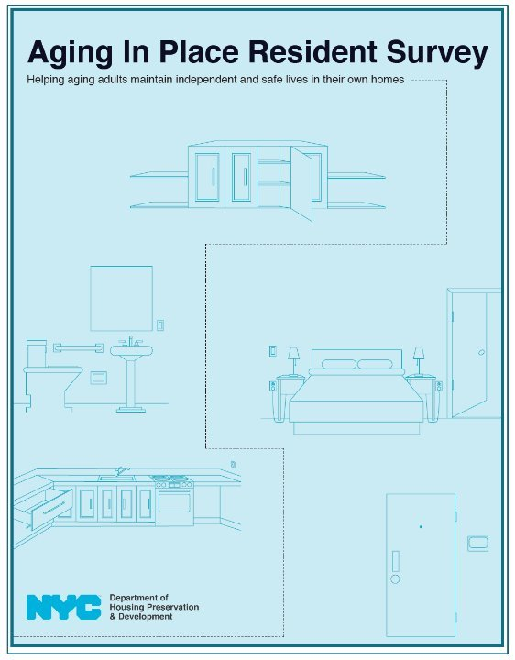
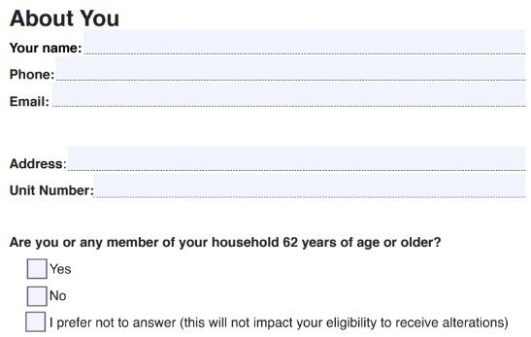
Linden Plaza Aging in Place + Resident Workshop
Page 3 of the handout
Please fill out the section titled About You
Address and Unit Number : VERY IMPORTANT!!!!
Aging In Place Survey Form
6

Slide 7
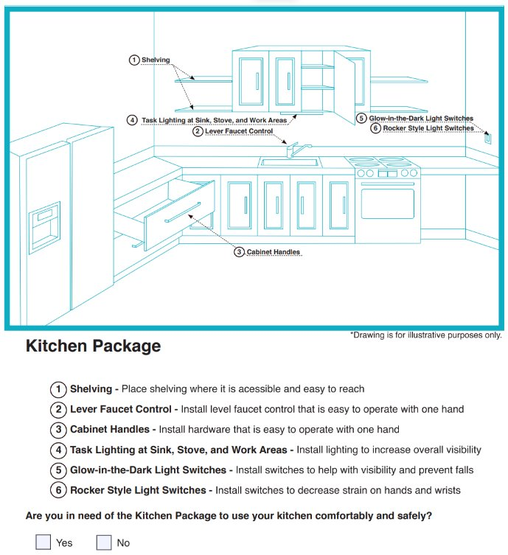
Linden Plaza Aging in Place + Resident Workshop
Standard HPD Aging In Place Kitchen Package : All or Nothing
Page 4 of the handout
Select YES if you WANT your apartment renovation to include the AIP Kitchen Package features
Select NO if you DO NOT WANT your apartment renovation to include the AIP Kitchen Package features
Aging In Place Survey Form
7

Slide 8
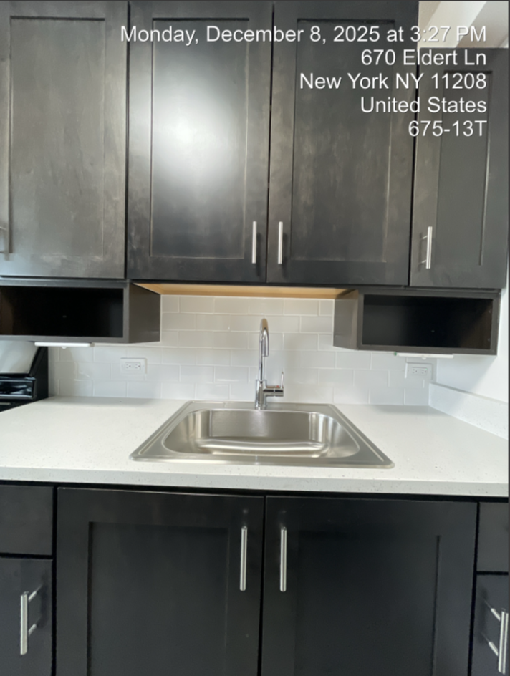
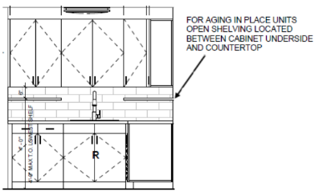
Linden Plaza Aging in Place + Resident Workshop
AIP Kitchen Package Modified Features For all Participants
The Aging-in-Place scope calls for open, accessible shelving.
To conserve storage space, the new open shelving location will hang from the bottom of the cabinets in instances where there is not enough room to provide accessible shelving elsewhere in the kitchen.
This shelving would reduce the height available for appliances above the countertop.
AIP Kitchen Package Modified Features
8

Slide 9
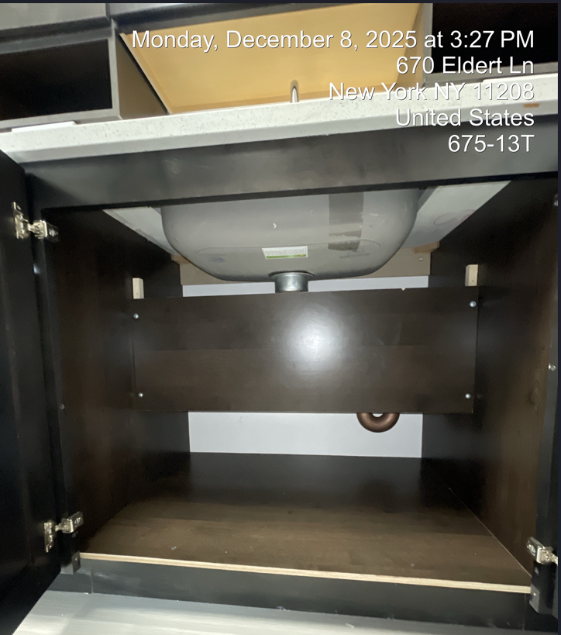
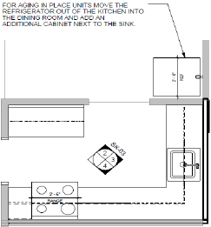
Linden Plaza Aging in Place + Resident Workshop
AIP Kitchen Package Modified Features for B-Line Residents ONLY
The layout of the B-line kitchens cannot accommodate both a wide accessible sink with removable cabinets below and refrigerator within the existing kitchen layout.
The refrigerator will be on the non-kitchen side of the small partial wall to maintain the Aging-in-Place sink features. The wall does not protrude past the refrigerator, and the space will feel like one continuous kitchen.
See page 11 of your handout to accept or reject this modification
AIP Kitchen Package Modified Features
9

Slide 10
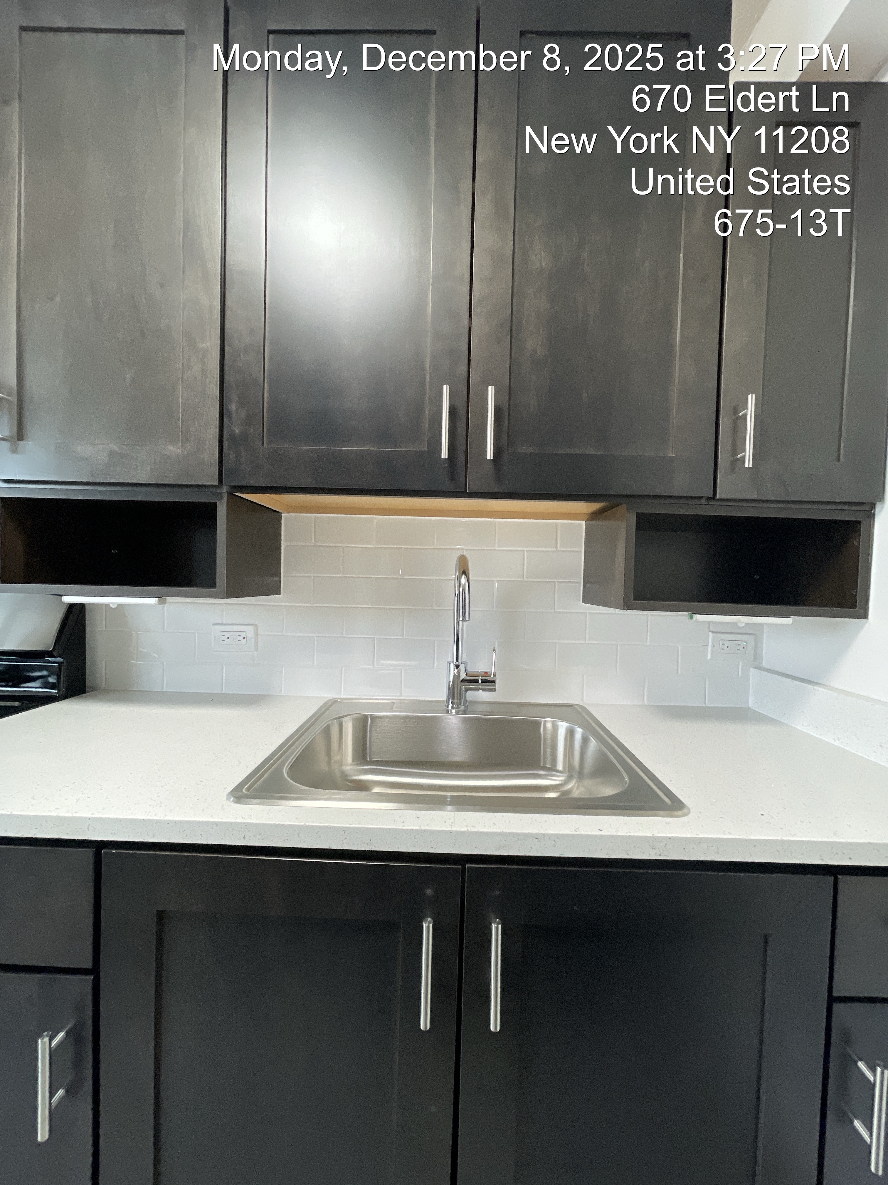
Linden Plaza Aging in Place + Resident Workshop
Kitchen Package Features
Open Shelving
Lever Faucets Controls
Cabinet Handles
Undercabinet Task Lighting
AIP Kitchen Package
10

Slide 11
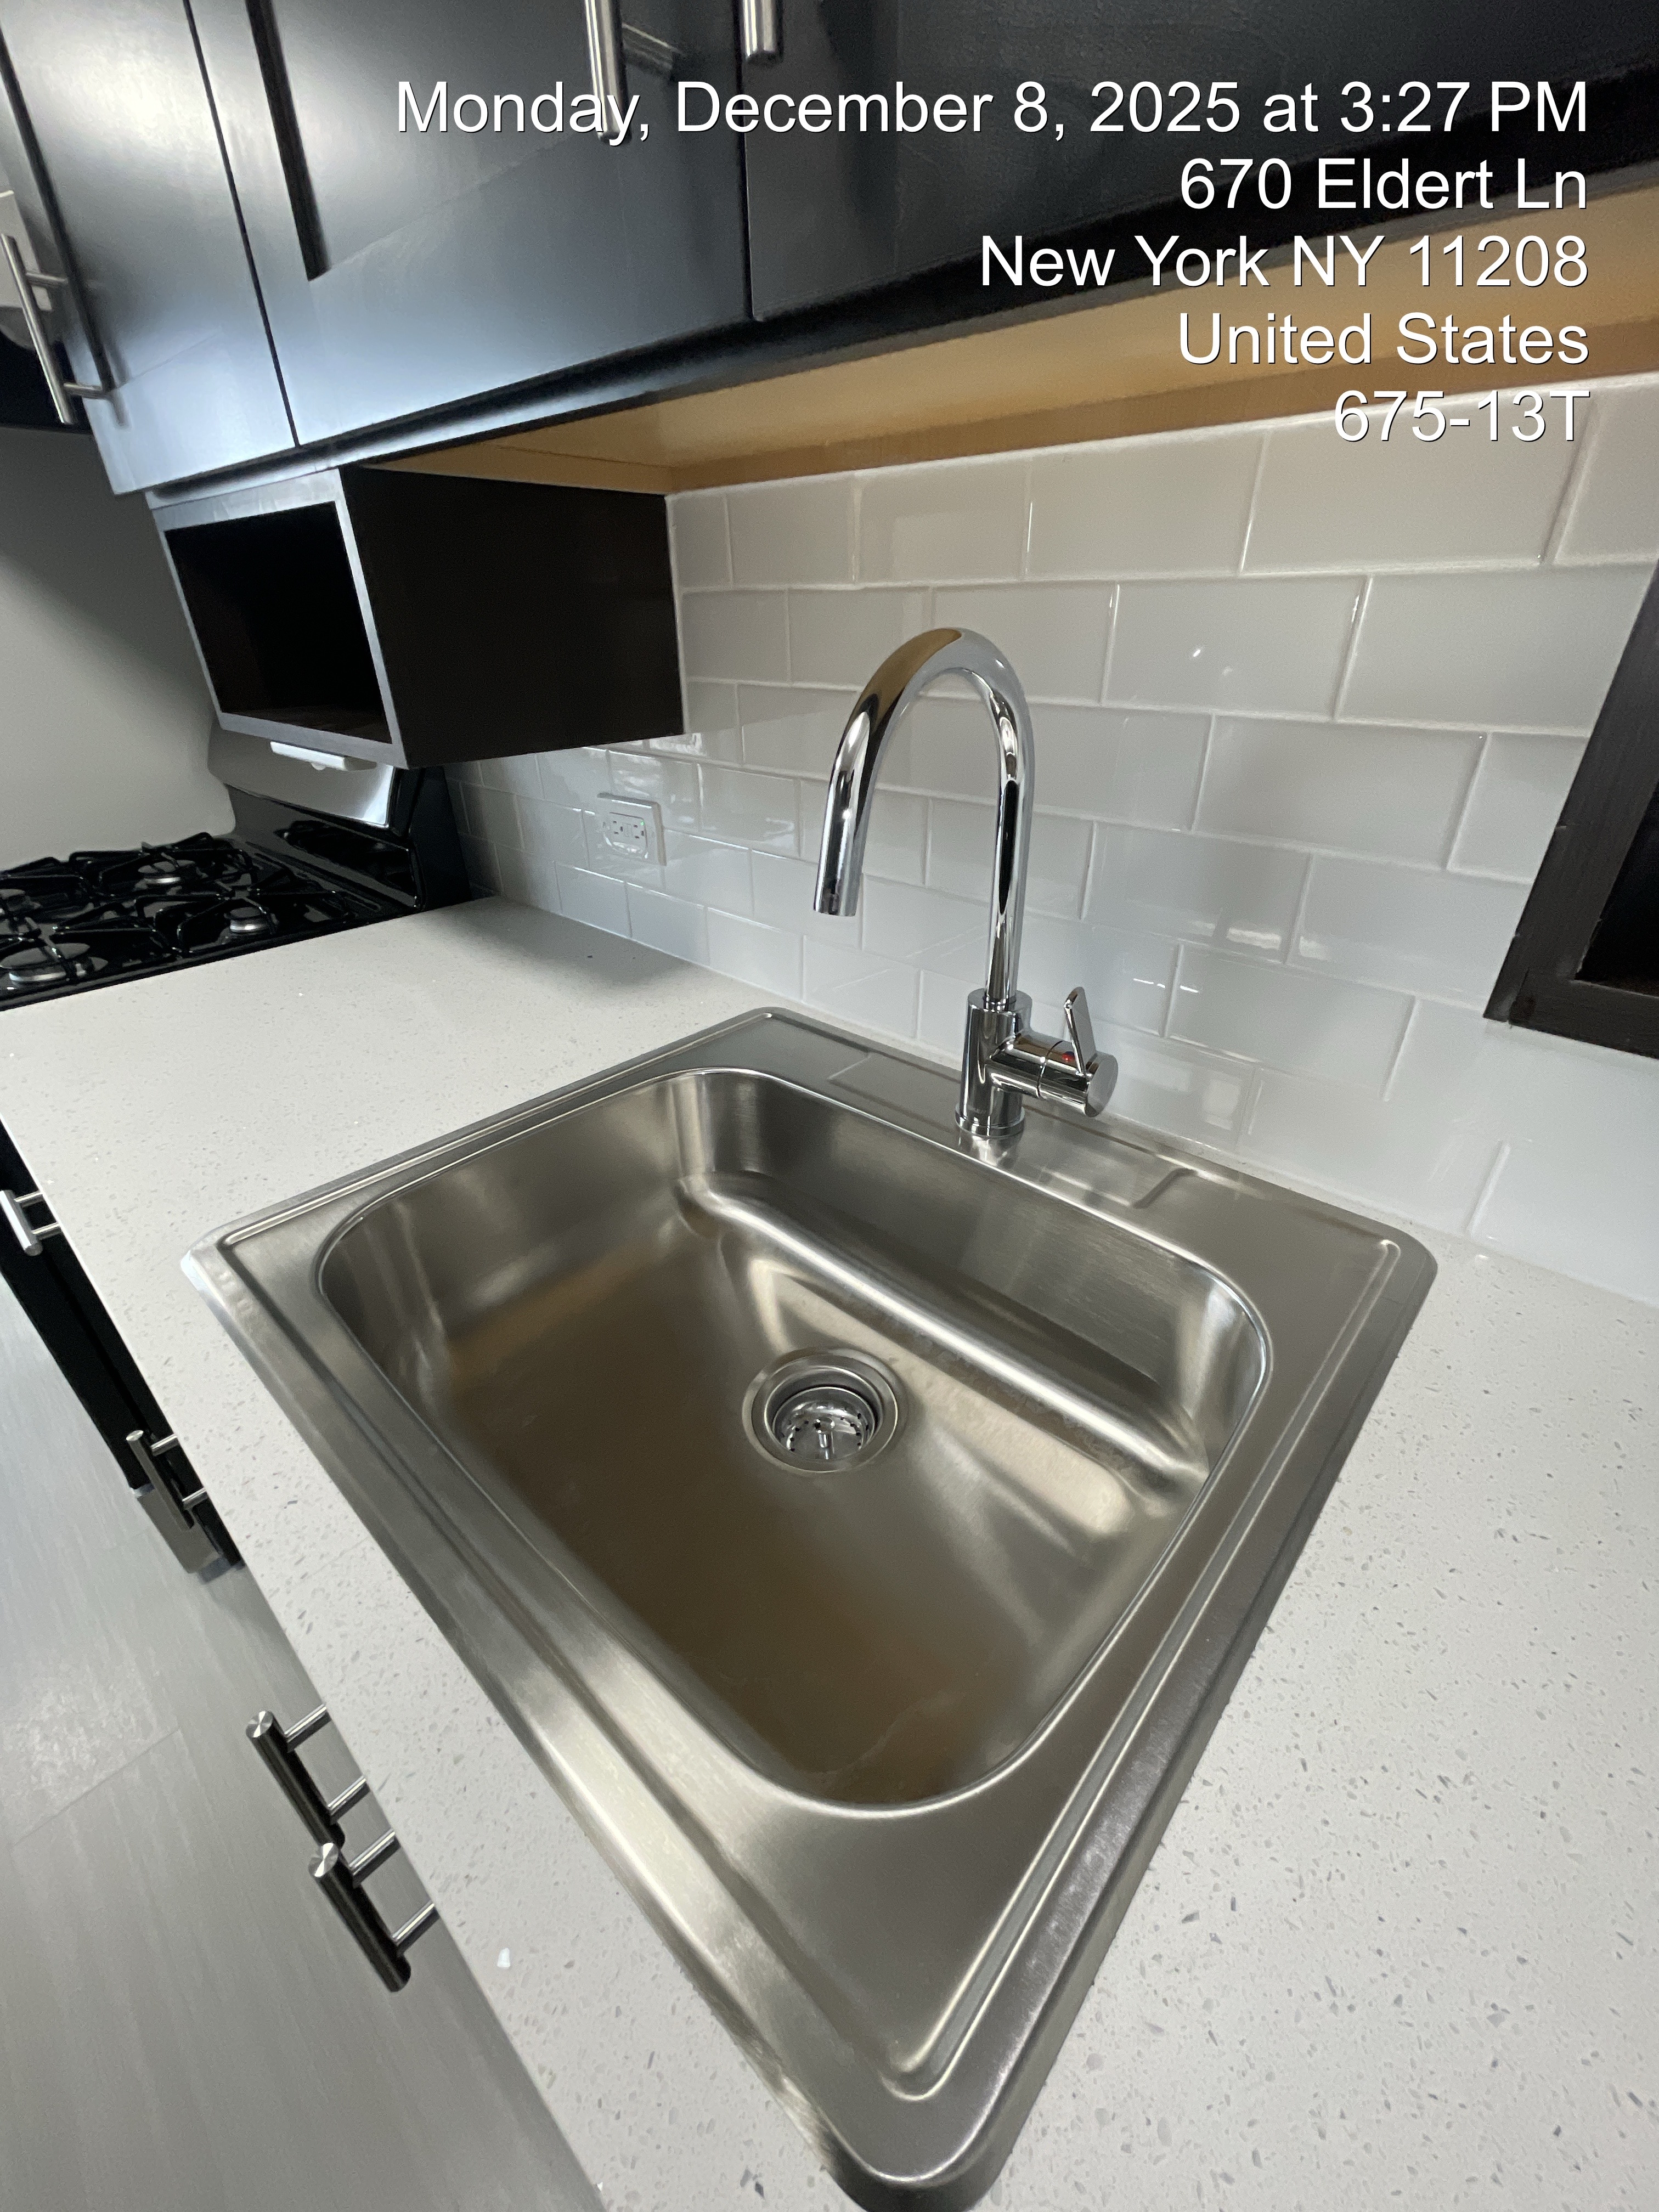
Linden Plaza Aging in Place + Resident Workshop
Kitchen Package Features
2. Lever Faucet Control
AIP Kitchen Package
11

Slide 12
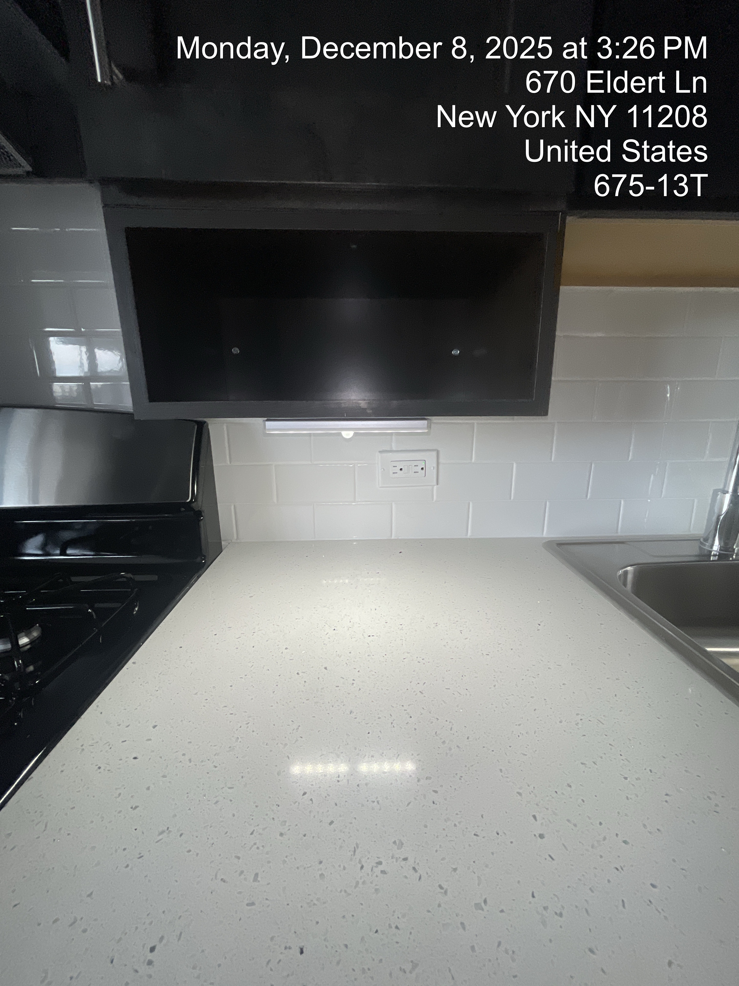
Linden Plaza Aging in Place + Resident Workshop
Kitchen Package Features
4. Undercabinet Task Lighting
AIP Kitchen Package
12

Slide 13
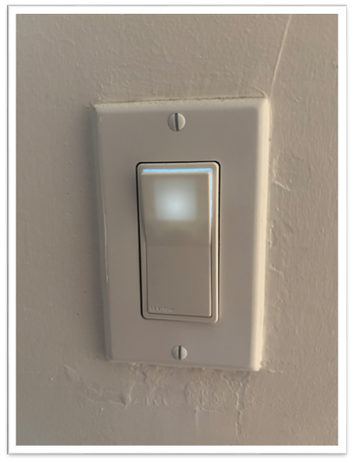
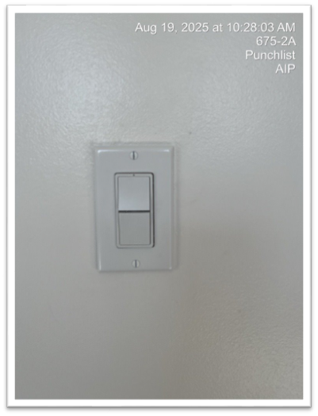
Linden Plaza Aging in Place + Resident Workshop
Kitchen Package Features
5. Glow-in-the-Dark Light Switches
6. Rocker Style Light Switches
AIP Kitchen Package
13

Slide 14
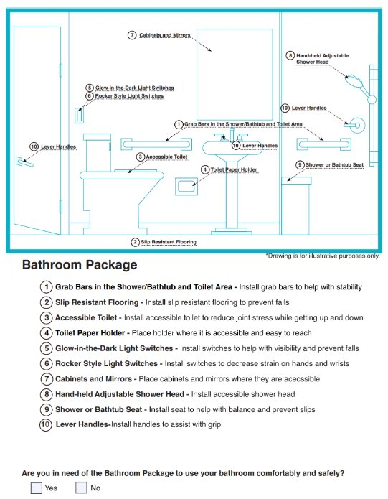
Linden Plaza Aging in Place + Resident Workshop
Standard HPD Aging In Place Bathroom Package : All or Nothing
Page 5 of the handout​
Select YES if you WANT your apartment renovation to include the AIP Bathroom Package features​
Select NO if you DO NOT WANT your apartment renovation to include the AIP Bathroom Package features
Aging In Place Survey Form
14

Slide 15
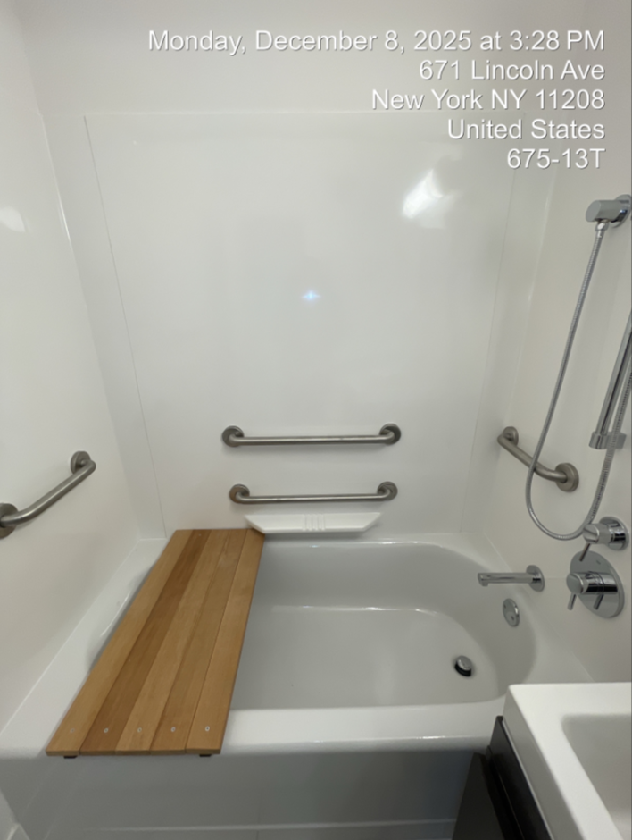
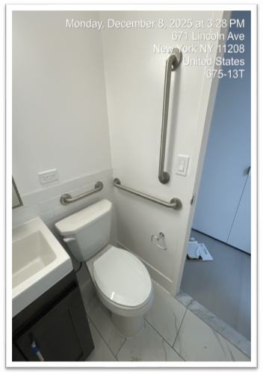
Linden Plaza Aging in Place + Resident Workshop
Bathoom Package Features
Grab bars in the Shower/Bathtub area and Toilet
9. Shower or Bathtub Seat
AIP Bathroom Package
15

Slide 16
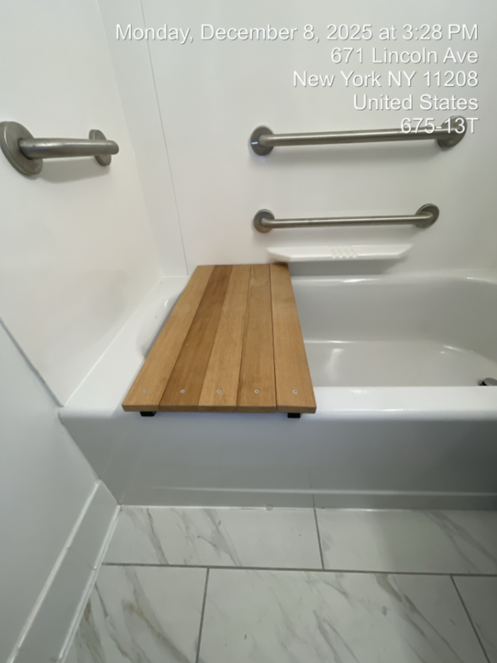
Linden Plaza Aging in Place + Resident Workshop
Bathoom Package Features
Grab bars in the Shower/Bathtub area and Toilet
9. Shower or Bathtub Seat
Worth Noting:
New bathtubs are 5" higher than existing tubs
AIP Bathroom Package
16

Slide 17
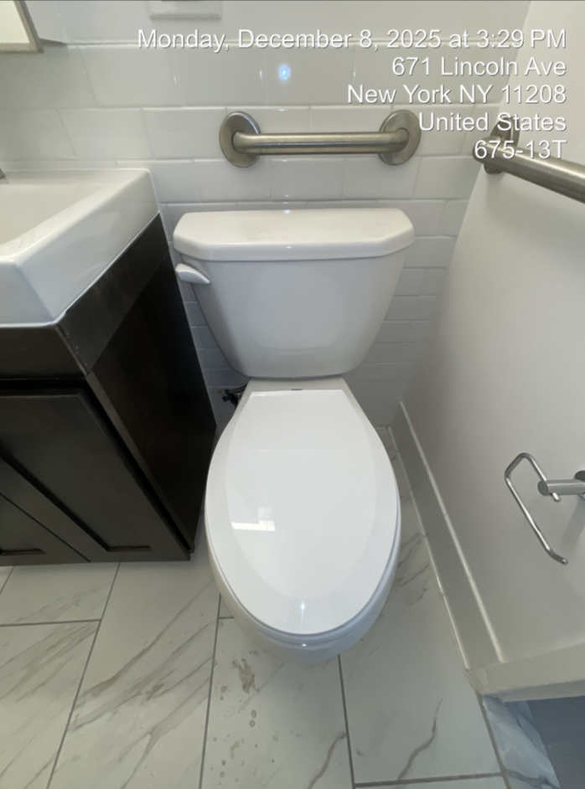
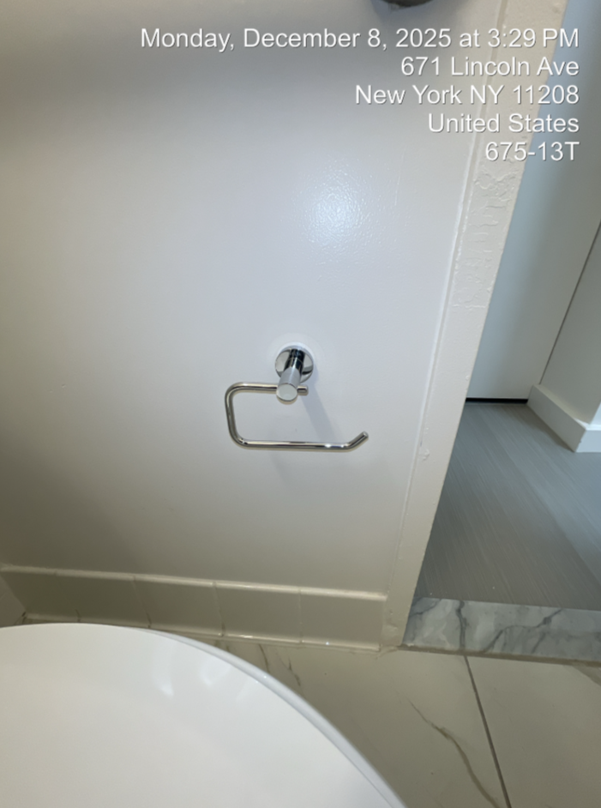
Linden Plaza Aging in Place + Resident Workshop
Bathoom Package Features
2. Slip Resistant Flooring
3. Accessible toilet
    17-1/8" ADA Compliant Toilet
4. Toilet Paper Holder
AIP Bathroom Package
17

Slide 18
Linden Plaza Aging in Place + Resident Workshop
Bathoom Package Features
5. Glow-in-The Dark Light Switches
6. Rocker Style Light Switches
AIP Bathroom Package
18

Slide 19
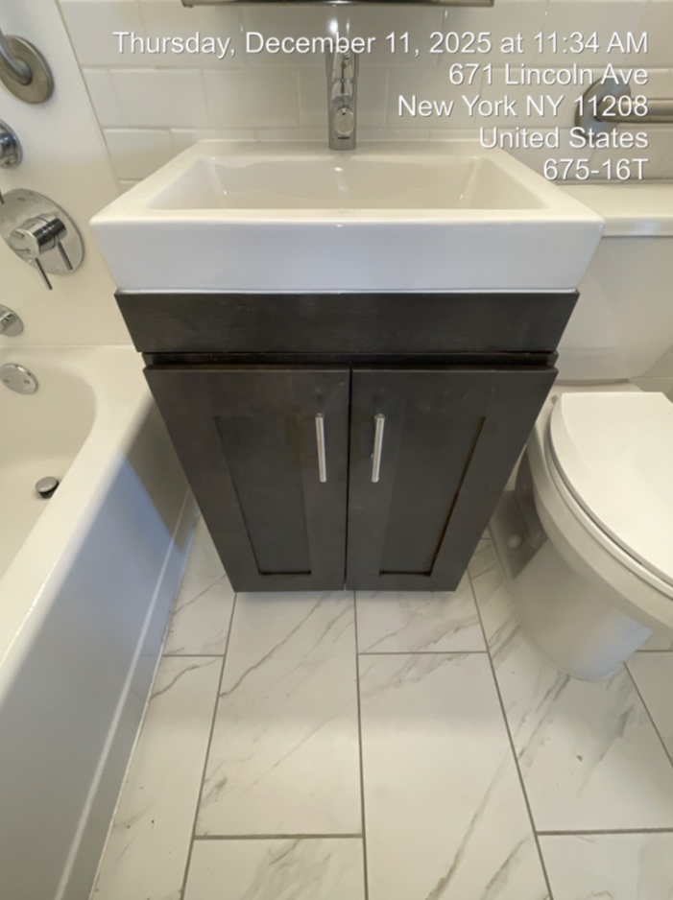
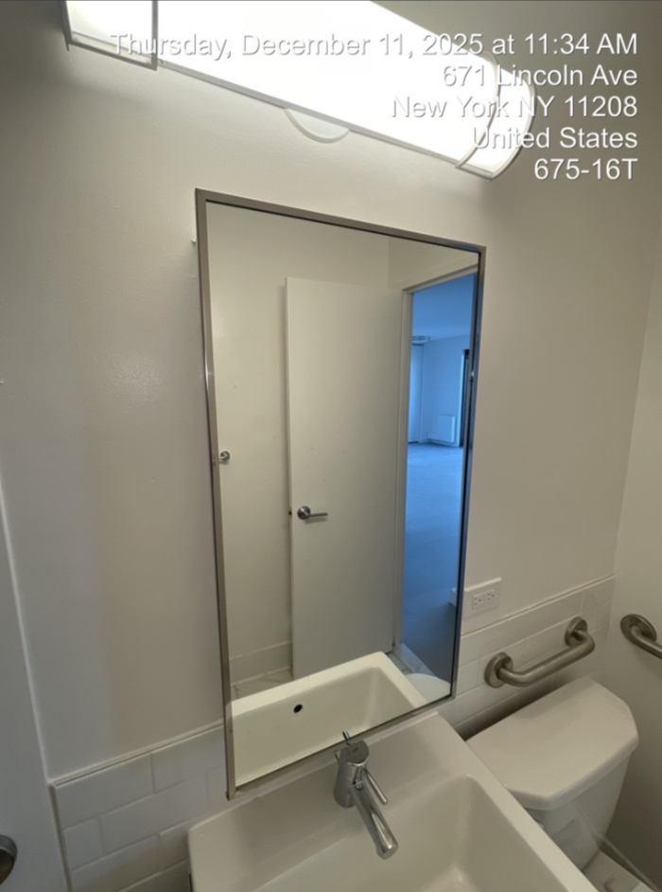
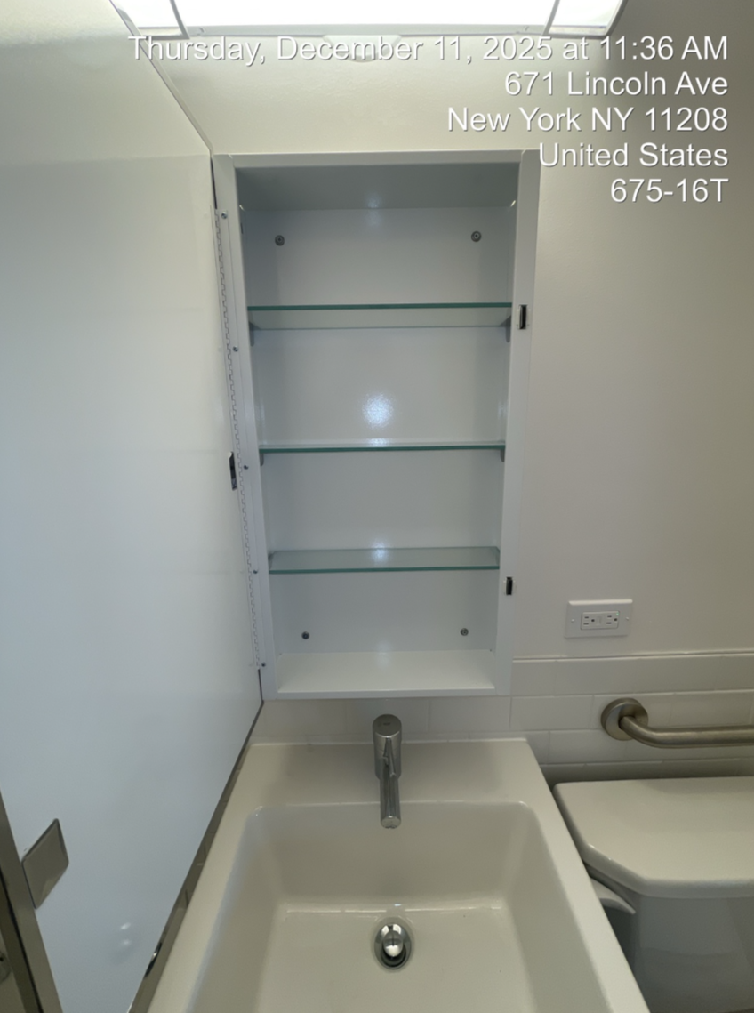
Linden Plaza Aging in Place + Resident Workshop
Bathoom Package Features
7. Accessible Cabinets and Mirrors
AIP Bathroom Package
19

Slide 20
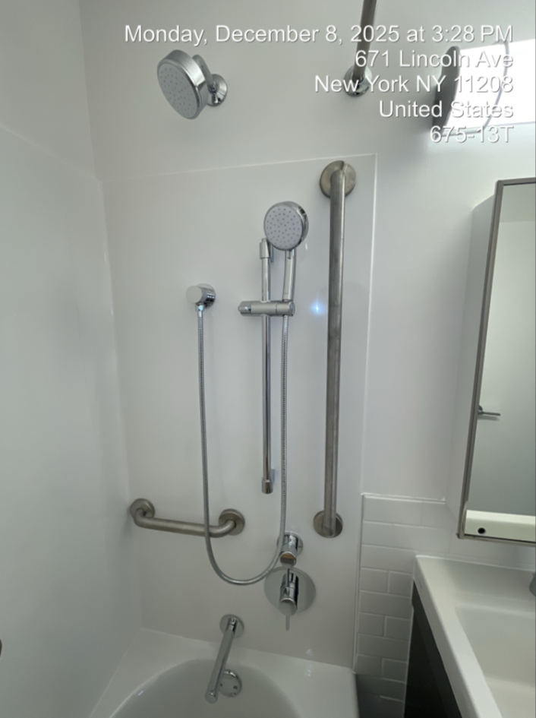
Linden Plaza Aging in Place + Resident Workshop
Bathoom Package Features
8. Handheld Adjustable Shower Head
AIP Bathroom Package
20

Slide 21
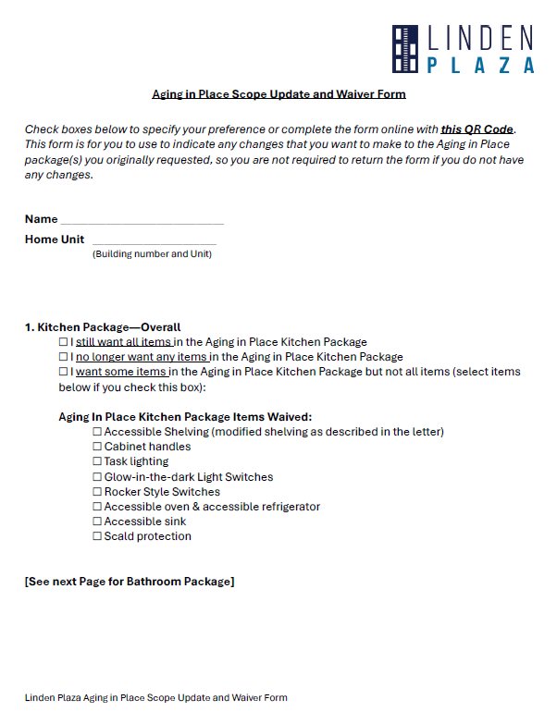
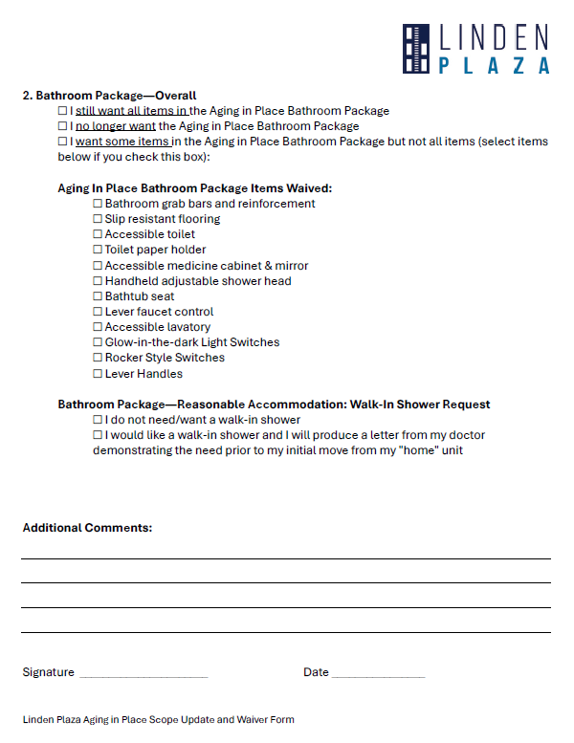
Linden Plaza Aging in Place + Resident Workshop
Al a Carte Selections
See page 12 of the handout to make al a carte selections from the Kitchen Package
See page 13 of the hand out to make al a carte selections for the Bathroom Package
AIP Kitchen & Bathroom Al a Carte Option
21

Slide 22
.02 Walk-In Shower
22

Slide 23
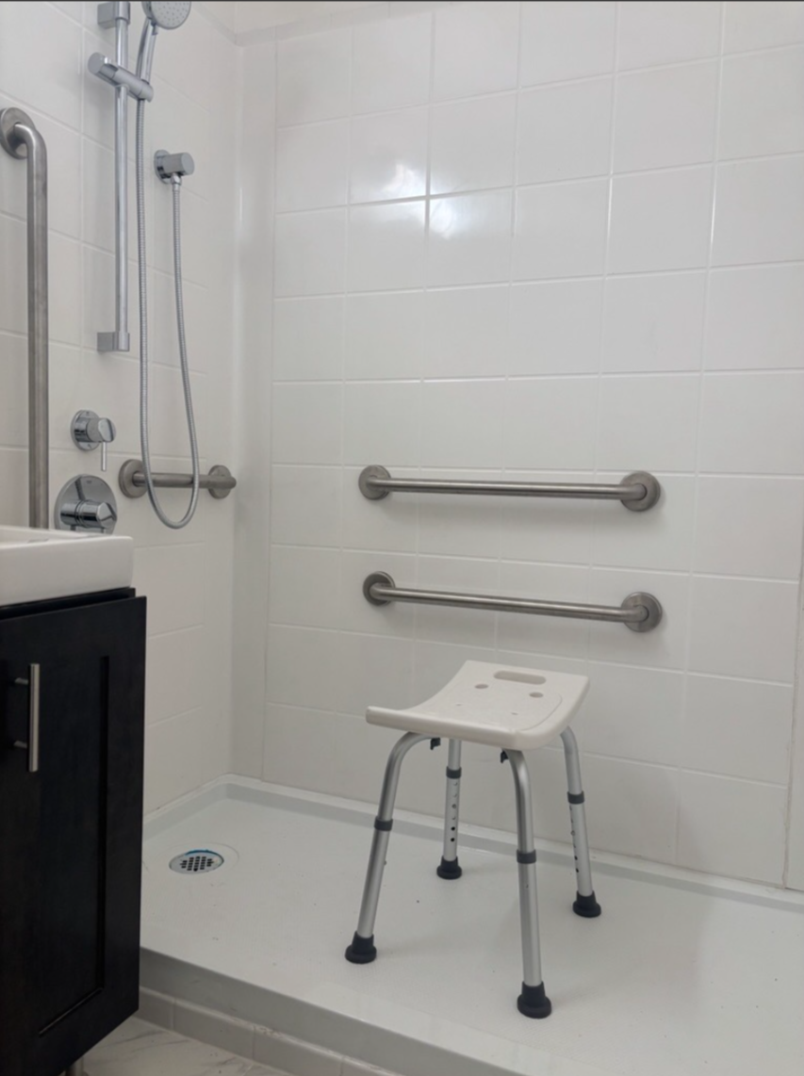
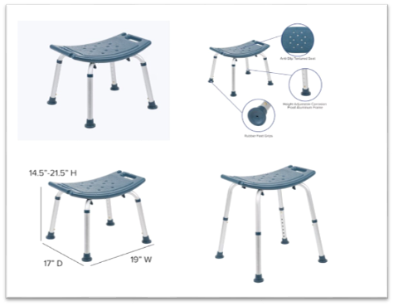
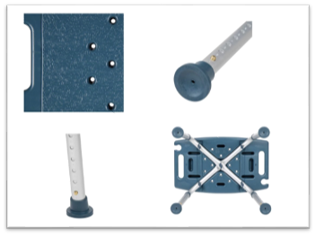
Linden Plaza Aging in Place + Resident Workshop
Walk-in Shower: Available as a Reasonable Accommodation with Doctor's Letter
Walk-In Shower
23

Slide 24
Linden Plaza Aging in Place + Resident Workshop
Bathroom Package – Reasonable Accommodation Walk-in Shower Request
See page 13 of the handout
Please select the option that best suites your need for a walk-in shower:
    I do not need/want a walk-in shower
    I would like a walk-in shower and I will produce a letter from my doctor demonstration the need prior to my initial move from my "home" unit.
AIP Kitchen & Bathroom Al a Carte Option
24

Slide 25
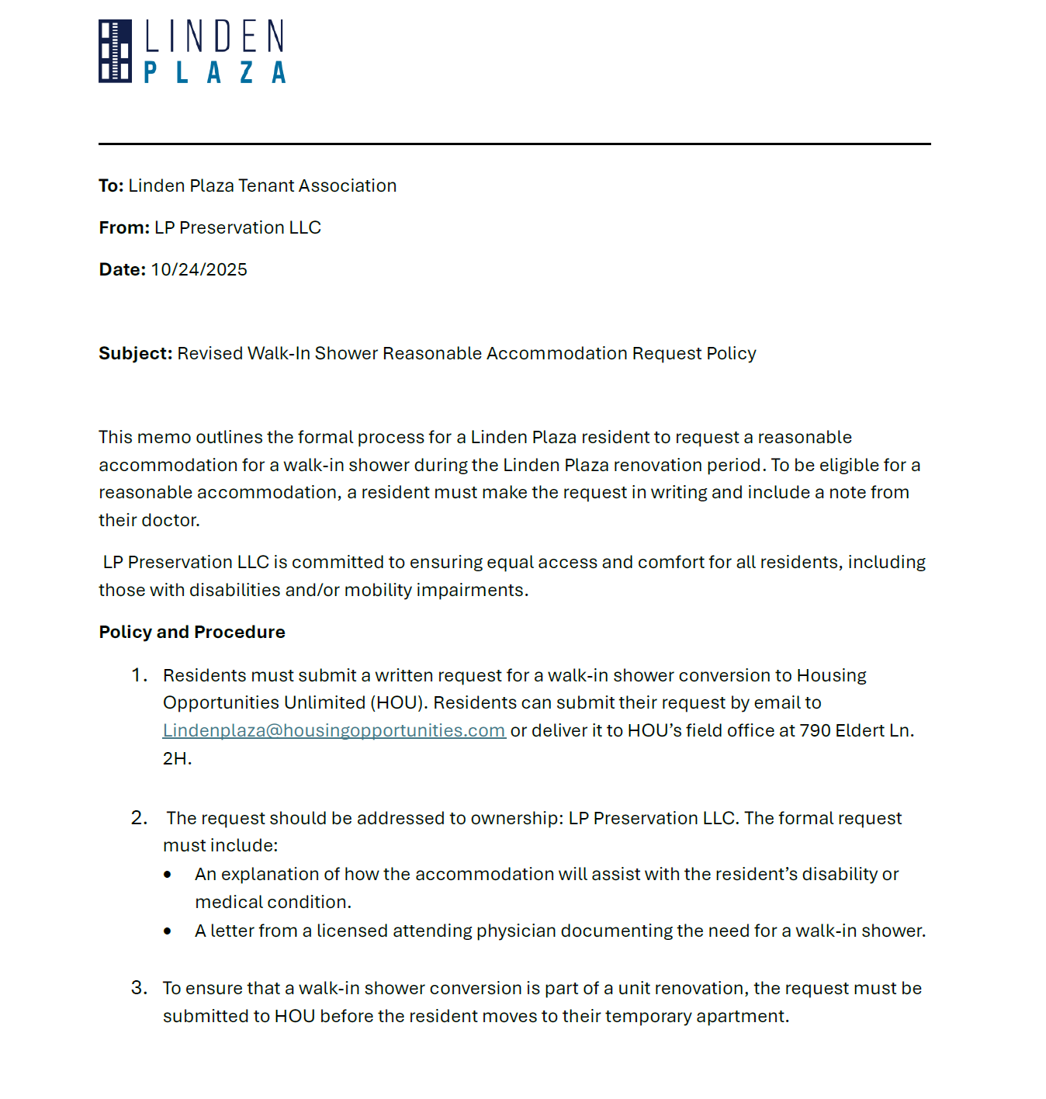
Linden Plaza Aging in Place + Resident Workshop
Walk-in Shower: Available as a Reasonable Accommodation with Doctor's Letter
See page 14 of the handout for the Walk-In Shower Reasonable Accommodation Request Policy
Walk-In Shower
25

Slide 26
.03 Hearing and Visually Impaired (HVI) Features
26

Slide 27
Linden Plaza Aging in Place + Resident Workshop
HVI: Hearing and Visually Impaired / Apartment Features
Intended audience are individuals with hearing and visual impairments.
Hearing and Visual Apartment Fixtures:
Hearing and Visual Doorbell
  Description: Equipped with both an audible chime and flashing strobe light, these doorbells alert residents who are deaf or hard of hearing when someone rings at the front door
    Exterior Fixture: Doorbell Installed next to door frame
    Interior Fixture: Doorbell strobe light installed in Living Room and Bedroom(s)
Hearing and Visual CO2 / Smoke Detector
  Description: Produces a high-decibel sound and high-intensity strobe light that flashes rapidly when smoke is detected.
    Interior Fixture: Within 15ft of the entrance door and entrance to Bedroom(s)
HVI: Hearing and Visual Features
27

Slide 28
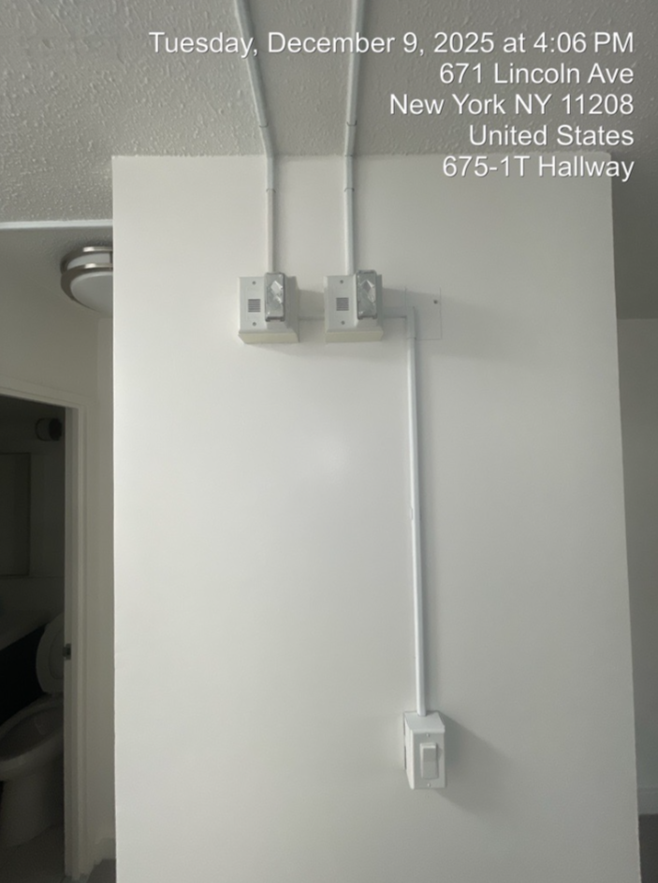
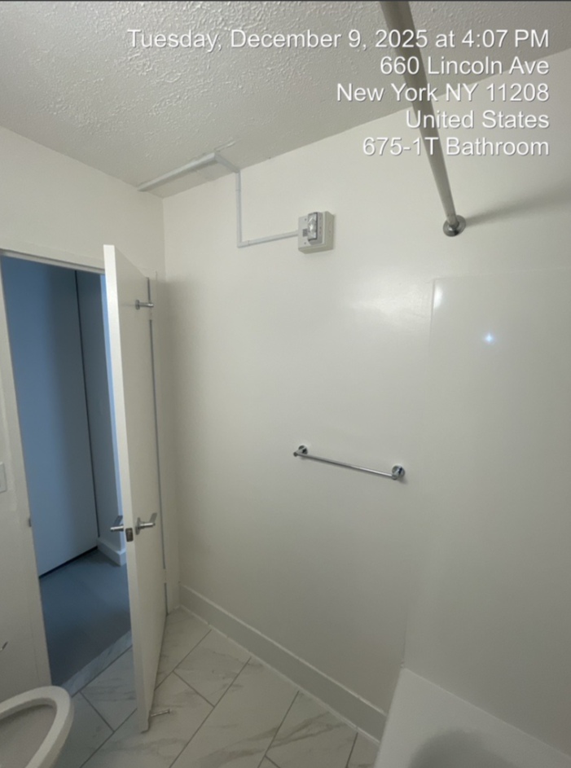
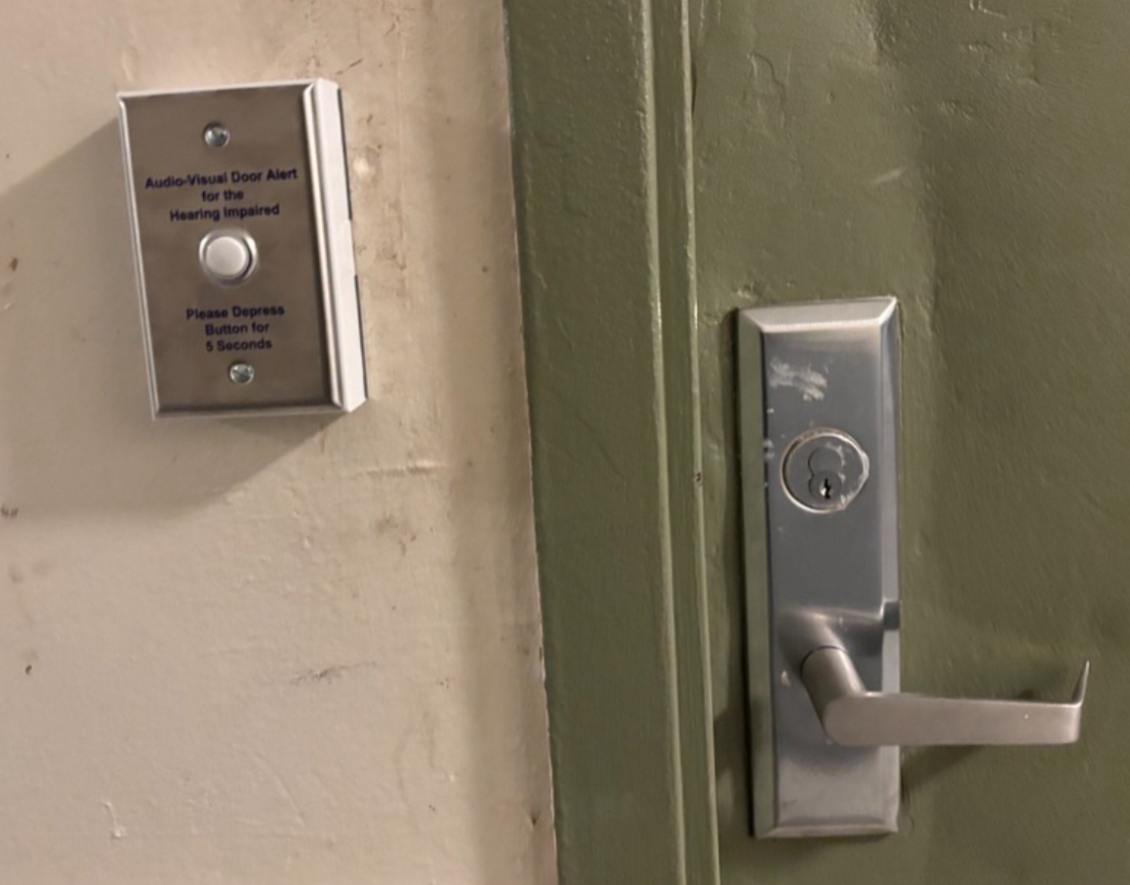
Linden Plaza Aging in Place + Resident Workshop
Hearing and Visual Apartment Fixtures:
Hearing and Visual Doorbell
    Exterior Fixture: Doorbell Installed next to door frame
    Interior Fixture: Doorbell strobe light installed in Living Room and Bedroom(s)
2. Hearing and Visual CO2 / Smoke Detector
    Interior Fixture: Within 15ft of the entrance door and entrance to Bedroom(s)
HVI: Hearing and Visual Features
28

Slide 29
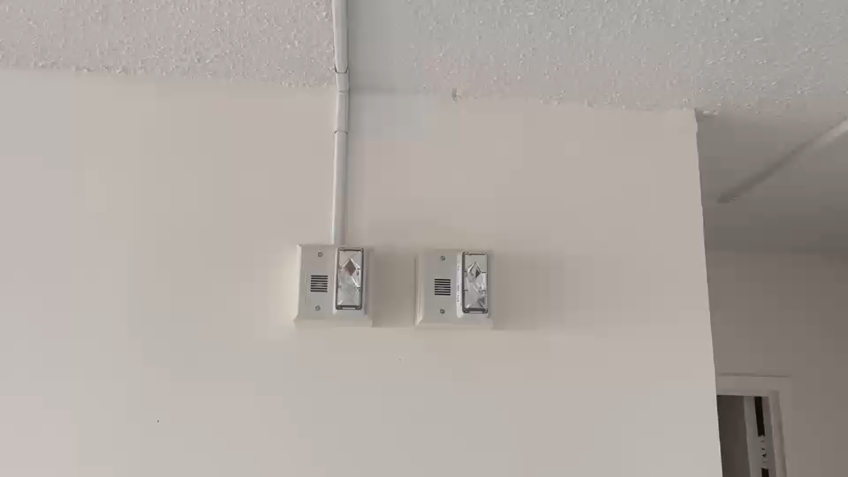
Linden Plaza Aging in Place + Resident Workshop
Hearing and Visual Apartment Fixtures:
Hearing and Visual Doorbell
Hearing and Visual CO2 / Smoke Detector
HVI: Hearing and Visual Features
29

Slide 30
.04 Uniform Federal Accessibility Standard
(UFAS) Apartments
30

Slide 31
Linden Plaza Aging in Place + Resident Workshop
UFAS Apartments​
As part of the preservation of Linden Plaza 5% all apartments will be set aside for individuals with a Mobility Impairment (MI) and renovated according to Uniform Federal Accessibility Standards (UFAS).
76 apartments at Linden Plaza will be fully accessible.
These units will be renovated to be accessible for a person who uses a wheelchair.
UFAS units are projected to become available for occupancy in the fall of 2027.
Apartments in Building 2 (790 Eldert Ln) and Building 4 (765 Lincoln Avenue) will be converted to meet UFAS requirements.
Residents with a mobility impairment who are interested in transferring into a fully accessible unit should contact the Leasing and Compliance office to be added to the internal transfer waitlist.
UFAS Apartments
31

Slide 32
Linden Plaza Aging in Place + Resident Workshop
UFAS Apartment Features
Finishes for UFAS apartments are identical to non-UFAS apartments the only difference is height of fixtures and additional accessibility features.
Kitchen:
Accessible base cabinet
Lowered upper cabinets
Accessible sink
Accessible stove
Hood range control switches
Bathroom:
ADA compliant toilet
Grab bars
Handheld showerhead
Accessible vanity
Lowered medicine cabinet & mirror
Other Features:
Expanded entrance ways
Expanded through ways
Heightened or extended electrical outlets
Lowered closet rail and shelf
Ramp saddle at all thresholds
Automatic door opener
UFAS Apartments
32

Slide 33
Linden Plaza Aging in Place + Resident Workshop
Thank You for attending the
Linden Plaza Aging In Place +
Resident Workshop.
Before exiting, please submit your completed forms for the following:
HPD Aging in Place Resident Survey form
Linden Plaza Scope Update and Waiver Form (Al a carte selections)
Hearing and Visual Impairment (HVI) Fixtures Request Form
Receipt of these documents is required to ensure you receive the modifications you want to your apartment.
Please enjoy the rest of your day!
33

Slide 34
Linden Plaza

