Slide 1

Resident Meeting #2
June 12, 2024
Para Espanol:
Dial: 646-558-8656
ID: 497-692-7129

Slide 2
Resident Meeting #2
Agenda
  May Meeting Recap
  PBV Inspections and Repairs
  Relocation Overview
  Renovations Details and Vote
  Next Steps

Slide 3
1: May Meeting Recap

Slide 4
  Project Overview
  Working with HPD to create a comprehensive renovation plan to correct problems for the long-term.
  Top Priorities: fix all water leaks, complete overhaul of heating and hot water systems, address structural issues, upgrade kitchens and bathrooms, accessibility improvements throughout, and increased site security.
    Residents DO NOT have to pay out of pocket for these repairs and upgrades.
  Temporary relocation will be necessary to abate the hazardous materials in resident walls and to replace all plumbing riser pipes.
  Rent: Linden Plaza will remain in the Mitchell Lama program, and rent will continue to be governed by HPD.
  Resident Engagement Team will meet often with residents, to discuss concerns and set expectations.
Notes:
No one’s rents will increase – there will be relocation – correct mold and heat and long-term cure of the “implorable” conditions – reassure anxiety about relo – disabled and senior population
Add note about current conditions and goals to improve

Slide 5
Project-Based Vouchers (PBVs)
  A limited amount of new Project-Based Section 8 Vouchers (PBVs) will be offered.
  Linden Plaza residents who qualify will pay no more than 30% of their adjusted gross household income towards rent.
  Benefits Include:
    Rent payments sized on 30% of your income on rent.
    If you decide to move after 1 year, you can apply for a portable housing voucher.
    Unit will undergo HQS repairs and inspection prior to subsidy starting.
Notes:
Acknowledge issues with lost subsidies and rent increases
System in place to make sure this doesn’t happen. - coordination around compliance – Wavecrest with strong experience in these topics

Slide 6
Do You Qualify for Project-Based Vouchers?
  To qualify for PBVs, households must:
    Income certify
    Pass Housing Quality Standards (HQS) physical inspections
    Maintain a rightsized unit per HUD standards
Notes:
Add right sizing table

Slide 7
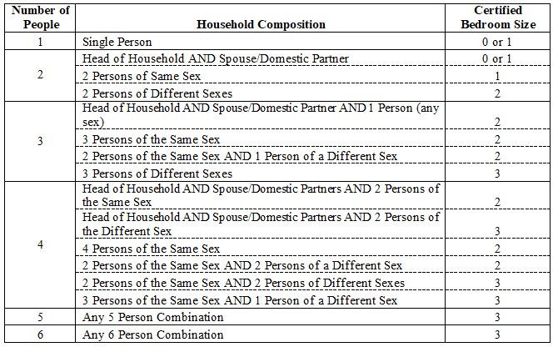
For PBV Applicants: Right Sizing
Your unit must also be rightsized. That means that your apartment’s household composition meets one of the breakdowns listed below. Note, if you are not currently rightsized, we can work with you to move you and your household into a correctly sized unit within Linden Plaza.

Slide 8
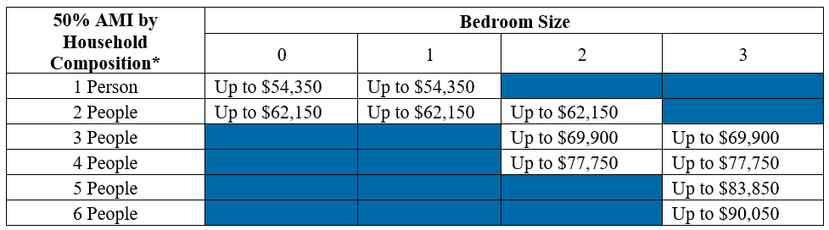
For PBV Applicants: Income Qualifying
  Your current income must be less than 50% of the Area Median Income (“AMI”). Your AMI varies based on the number of residents in your apartment. A breakdown of those AMI’s are below.

Slide 9
2: PBV Inspections and Repairs

Slide 10
PBV Applicants: Inspection and Repairs
Appt #1 | Appt #2 Appt #3 |  |  | Appt #4
 | Spring – Fall 2024 | HQS repair work for life/safety/quality housing | HQS Inspection
Preliminary review of apartment conditions
HQS repair work for life, safety, and quality housing
HQS Pre-Inspection to review repair work
Agency Inspection
Income certification along with HQS Inspector signoff must take place prior Section 8 subsidy starting.
Inspections are scheduled to happen anytime between 8:30 am and 3:30 pm. Please ensure that someone above the age of 18 will be present during that time frame to give entry into the unit.
Note, residents will have a minimum of four appointments. Your unit may need more depending on the conditions of the apartment.
Notes:
Be on the lookout for text or call

Slide 11
PBV Applicants: Preparing for Inspections
Write down the pre-scheduled inspection time and ensure all household members are aware of the time and date.
Secure pets and kept clear from inspection activities.
Tidy-up to ensure inspectors have clear walking paths throughout the apartment.
    Countertops should also be free of materials to facilitate measuring.
    Walls and windows should be accessible to facilitate measuring.
Someone age 18+ must be at home in order for inspectors to enter the unit.

Slide 12
5: Relocation Overview

Slide 13
Temporary Move Overview
Temp move is required due to environmental remediation related to the scope of work being performed in your apt.
All households must move temporarily (4-6 months) to an already renovated apartment at Linden Plaza.
Temporary moving costs will be covered 100% by ownership.
You will have a right to return to your original apartment.
Housing Opportunities Unlimited (HOU), temporary relocation experts, will support residents throughout the relocation process.
HOU will work with residents 1-on-1 to discuss individual needs and work on a Temporary Move Agreement.
Notes:
Fix formatting here

Slide 14
Temporary Move: What to Expect
What to Expect?
Your Responsibility
30-90 Days Before Temporary Move
HOU will meet 1 on-1 with each household to complete the Relocation Needs assessment.
Schedule a time to meet with the HOU team to complete the assessment when they call or leave a notice at your door. Meetings last between 30-60 minutes.
30 Days Before Temporary Move
Residents will be notified of their temporary relocation unit address and be provided packing materials and boxes to prepare for their move.
Review the notices. Begin packing your closets and loose items. Inform HOU if you need packing assistance.
Be present and ready on your move day. Let HOU know of bulk items you want to discard and empty your refrigerator and apartment of trash. You will need to give your keys to HOU by 5pm on move day.
Move Day
A licensed and insured moving company will complete your move in one day to your temporary relocation unit.

Slide 15
3: Renovation Details

Slide 16






Renovation Work will Take Place Over Four Years
May 2024 - Closing:
PBV HQS, Household Certifications, and Apartment Surveys
2024 Closing: Management Transition
2024 – 2028
Temp Relocation and Full Project Renovation
Commence rehab work immediately following financing
Apartment upgrades, landscaping, and improvements to major building envelope, systems and common areas

Slide 17
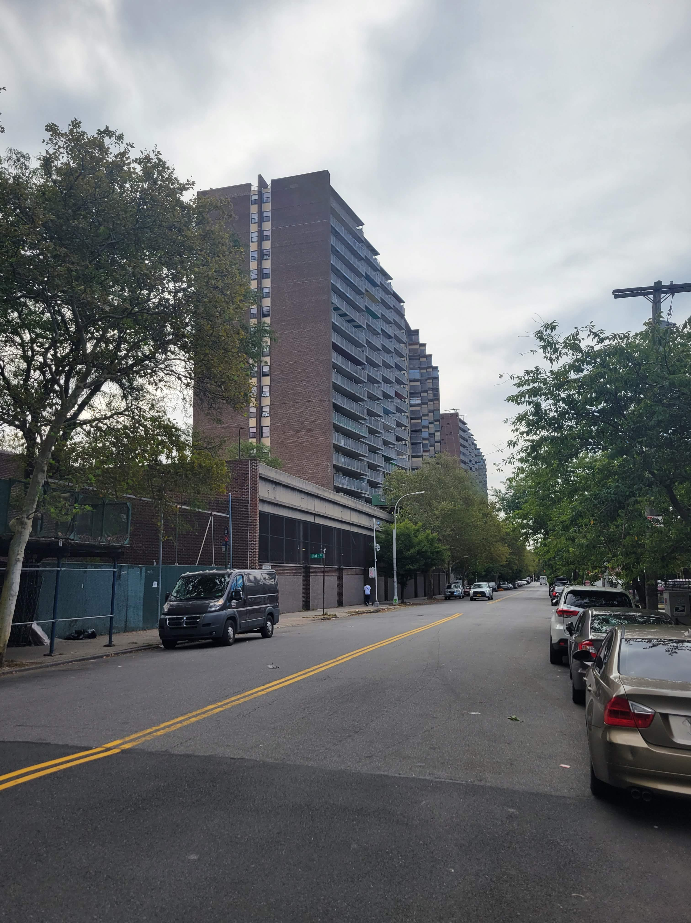
Renovations: Proposed Scope of Work
Comprehensive scope of work will provide long-lasting cures to decades-old conditions
In-unit renovations: New Kitchen, New Bathroom, New Flooring, and Painting
Building Envelope: Repairs to façade, roof and areas of water infiltration
Balconies: Railing and divider repairs, waterproof concrete
Plumbing: Full replacement of risers to prevent future leaks and mold
Heating: Repairs to heat plant and distribution
Structure: Repairs to concrete
Section 504: Improve accessibility conditions for disabled residents and allow seniors to age-in-place

Slide 18
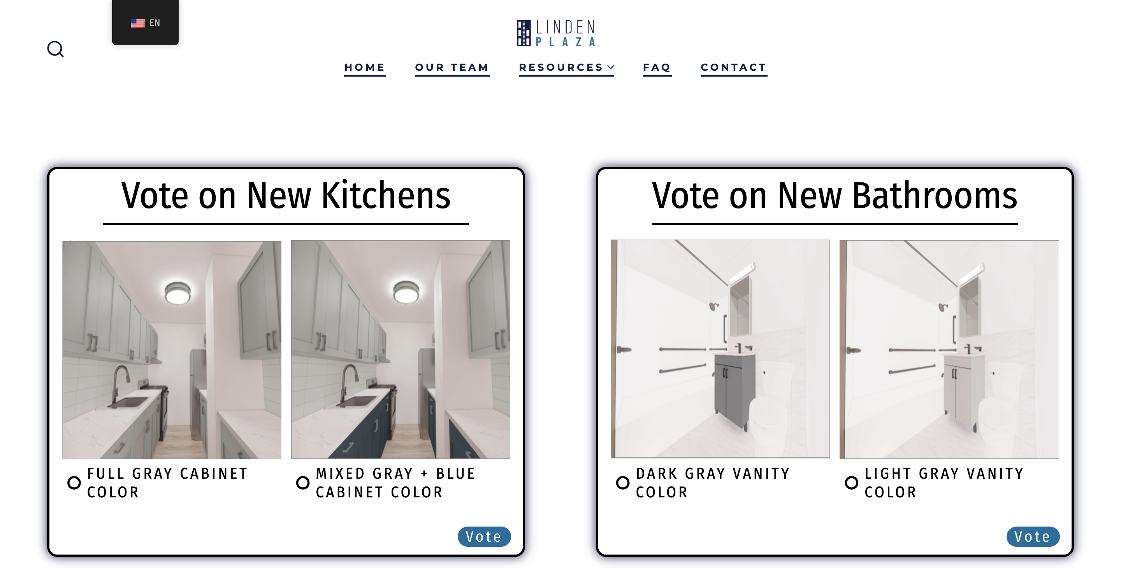
We Want Your Input!
  Vote on design items you want to see! Please limit the voting to once per household.

Slide 19
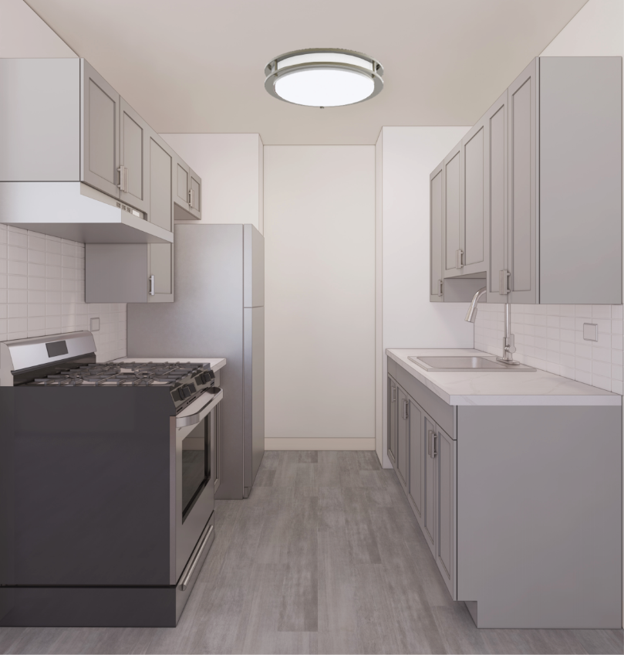
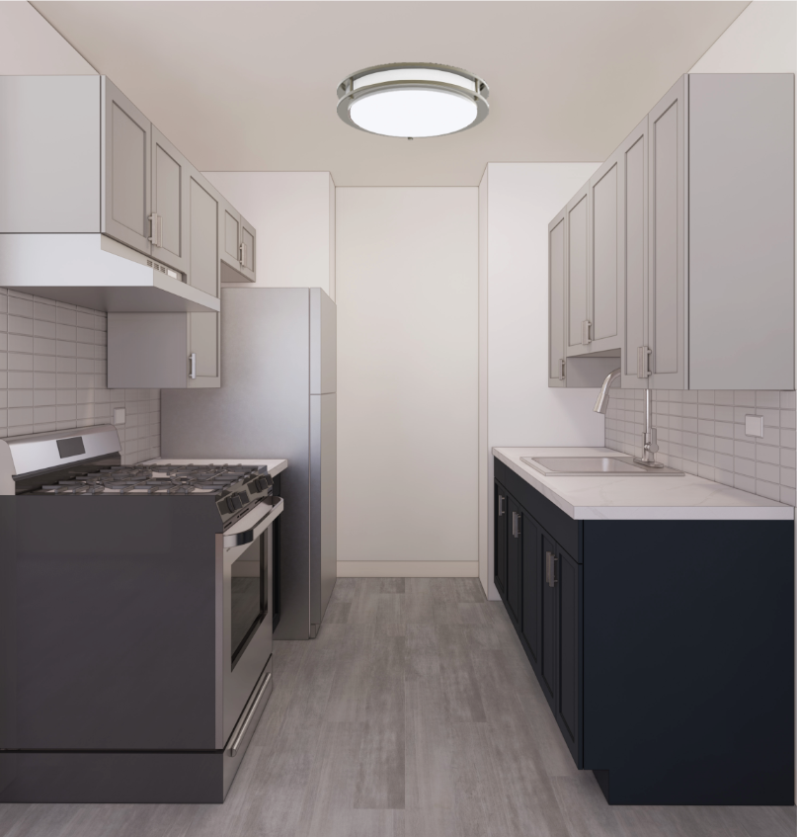
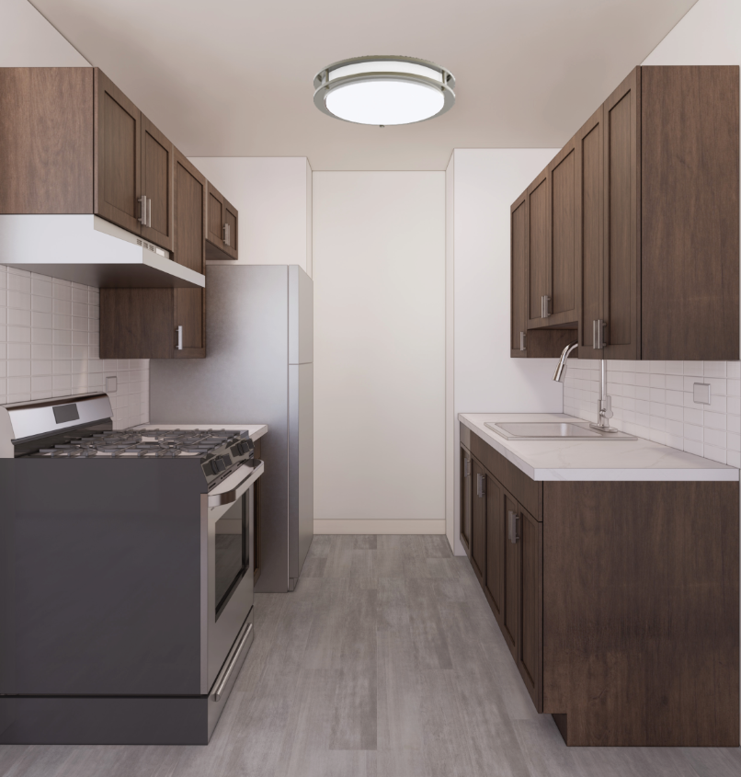
New Kitchens
  Vote now at LindenPlazaBK.com
  The winning option will be used at all apartments
Option A:
Full Gray Cabinet Color
Option B:
Mixed Gray + Blue Cabinet Color
Option C:
Full Brown Cabinet Color
  For Illustrative Purpose: Apartment Kitchen. Flooring options are still under SHPO review

Slide 20
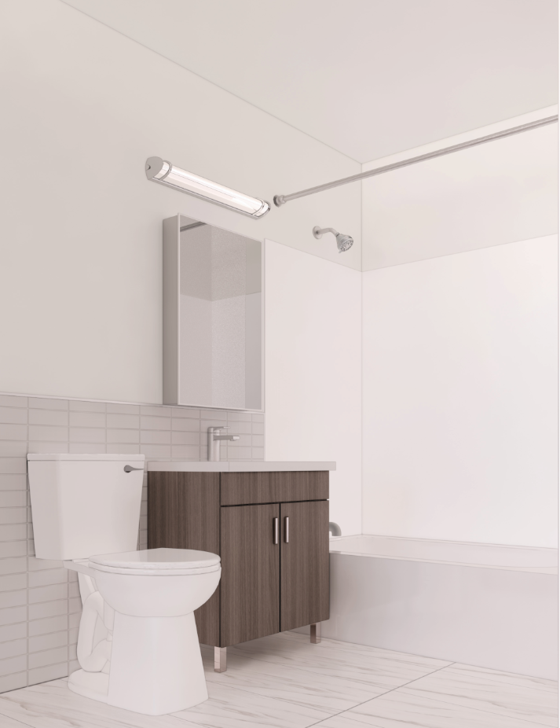
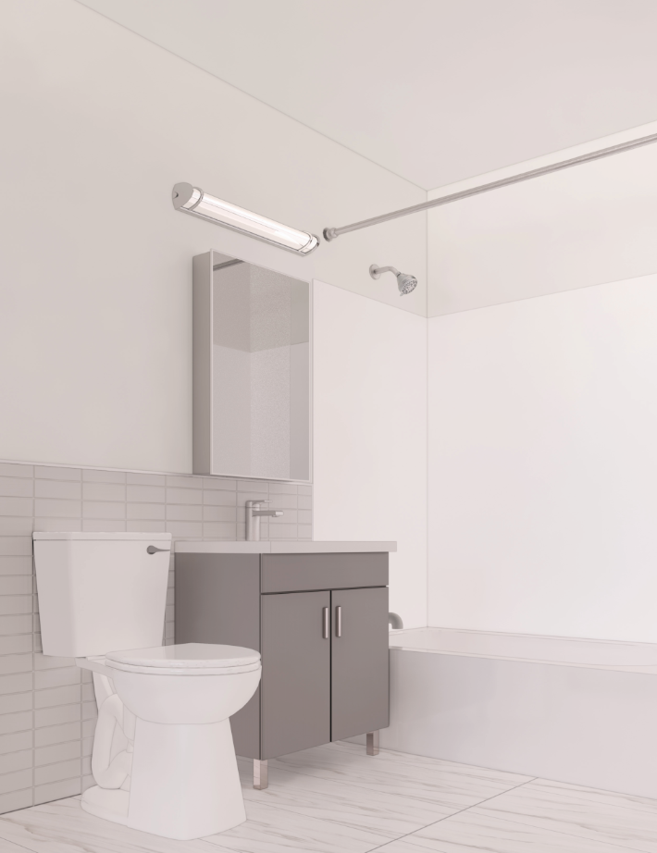
New Bathrooms
  Vote now at LindenPlazaBK.com
  The winning option will be used at all apartments
Option A:
Brown Vanity Color
Option B:
Grey Vanity Color

Slide 21
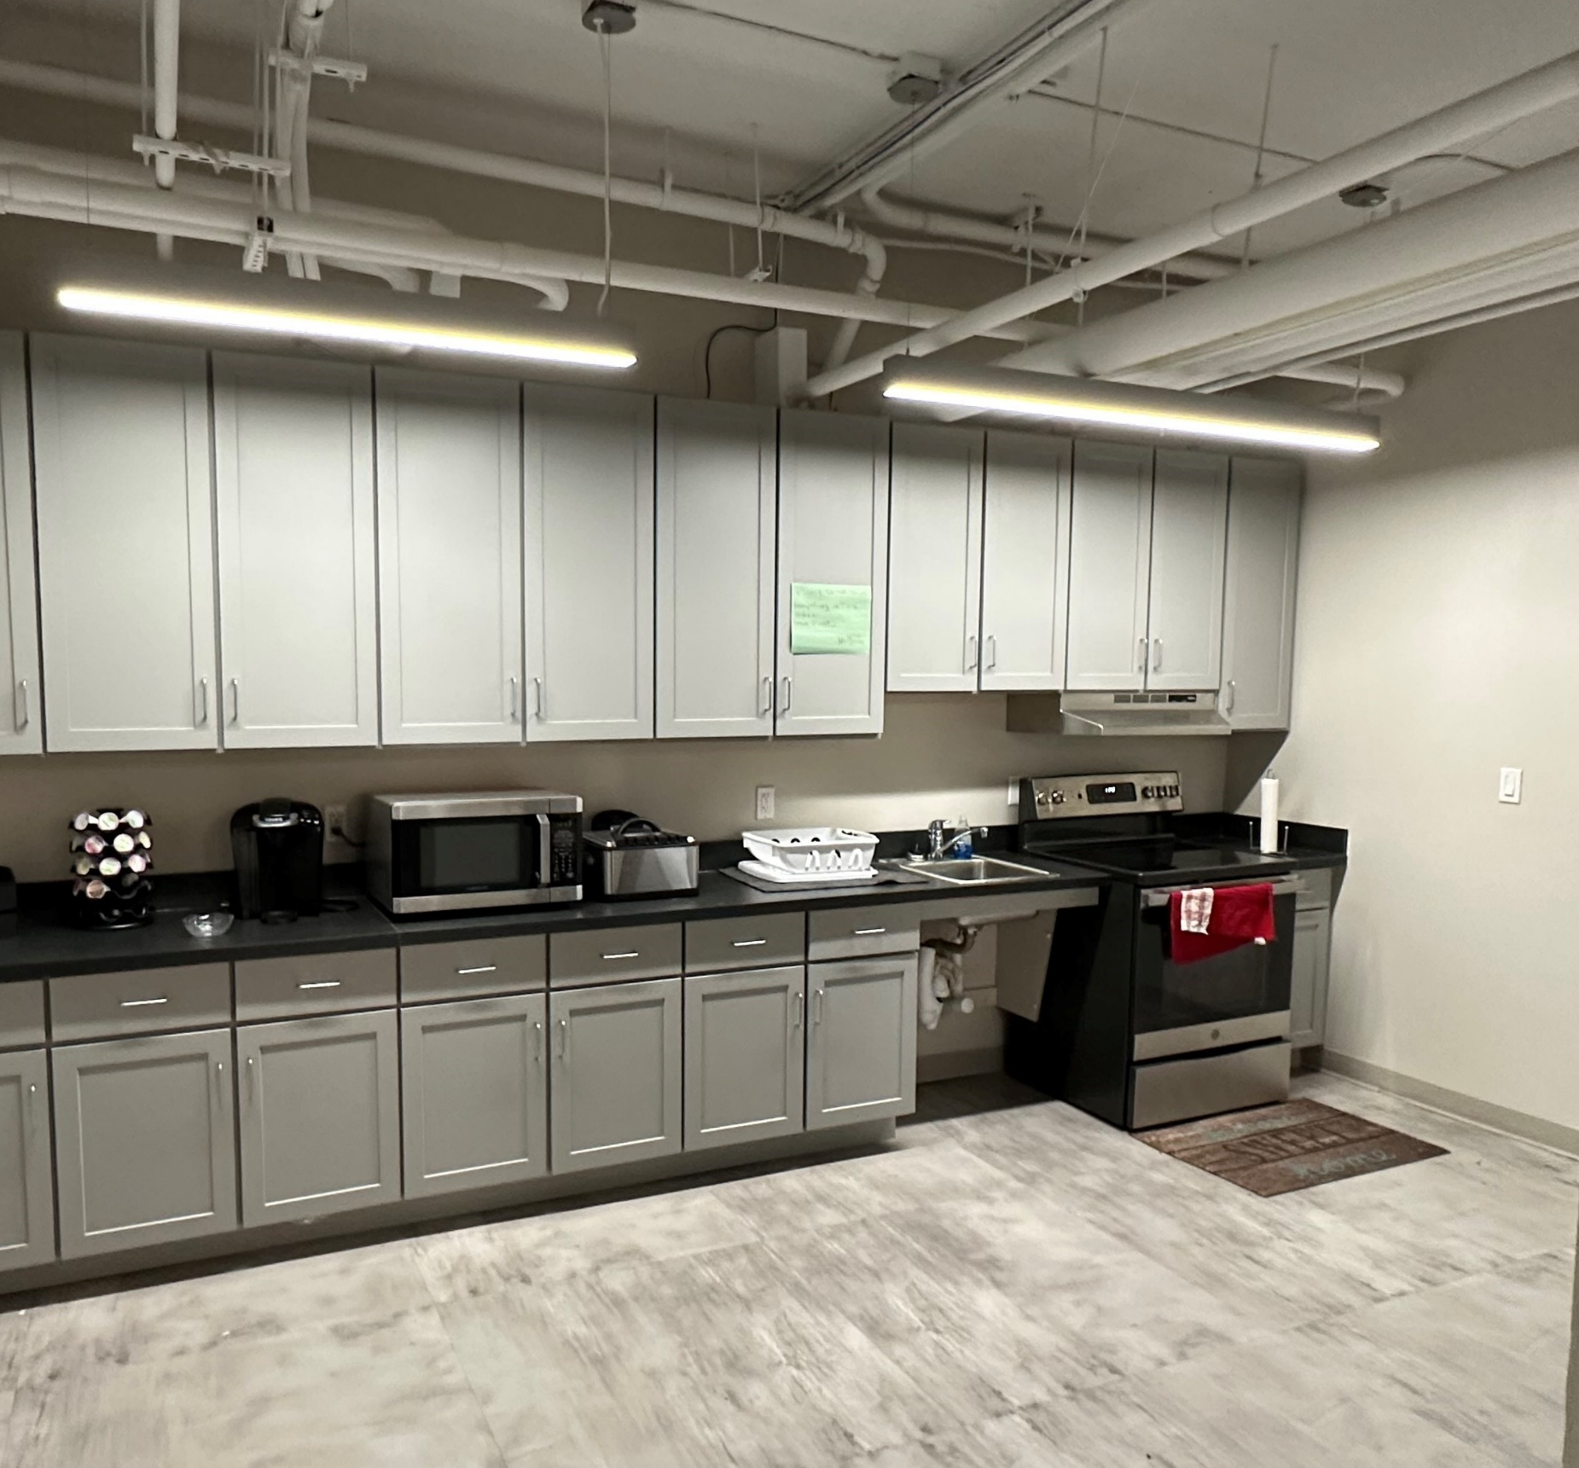
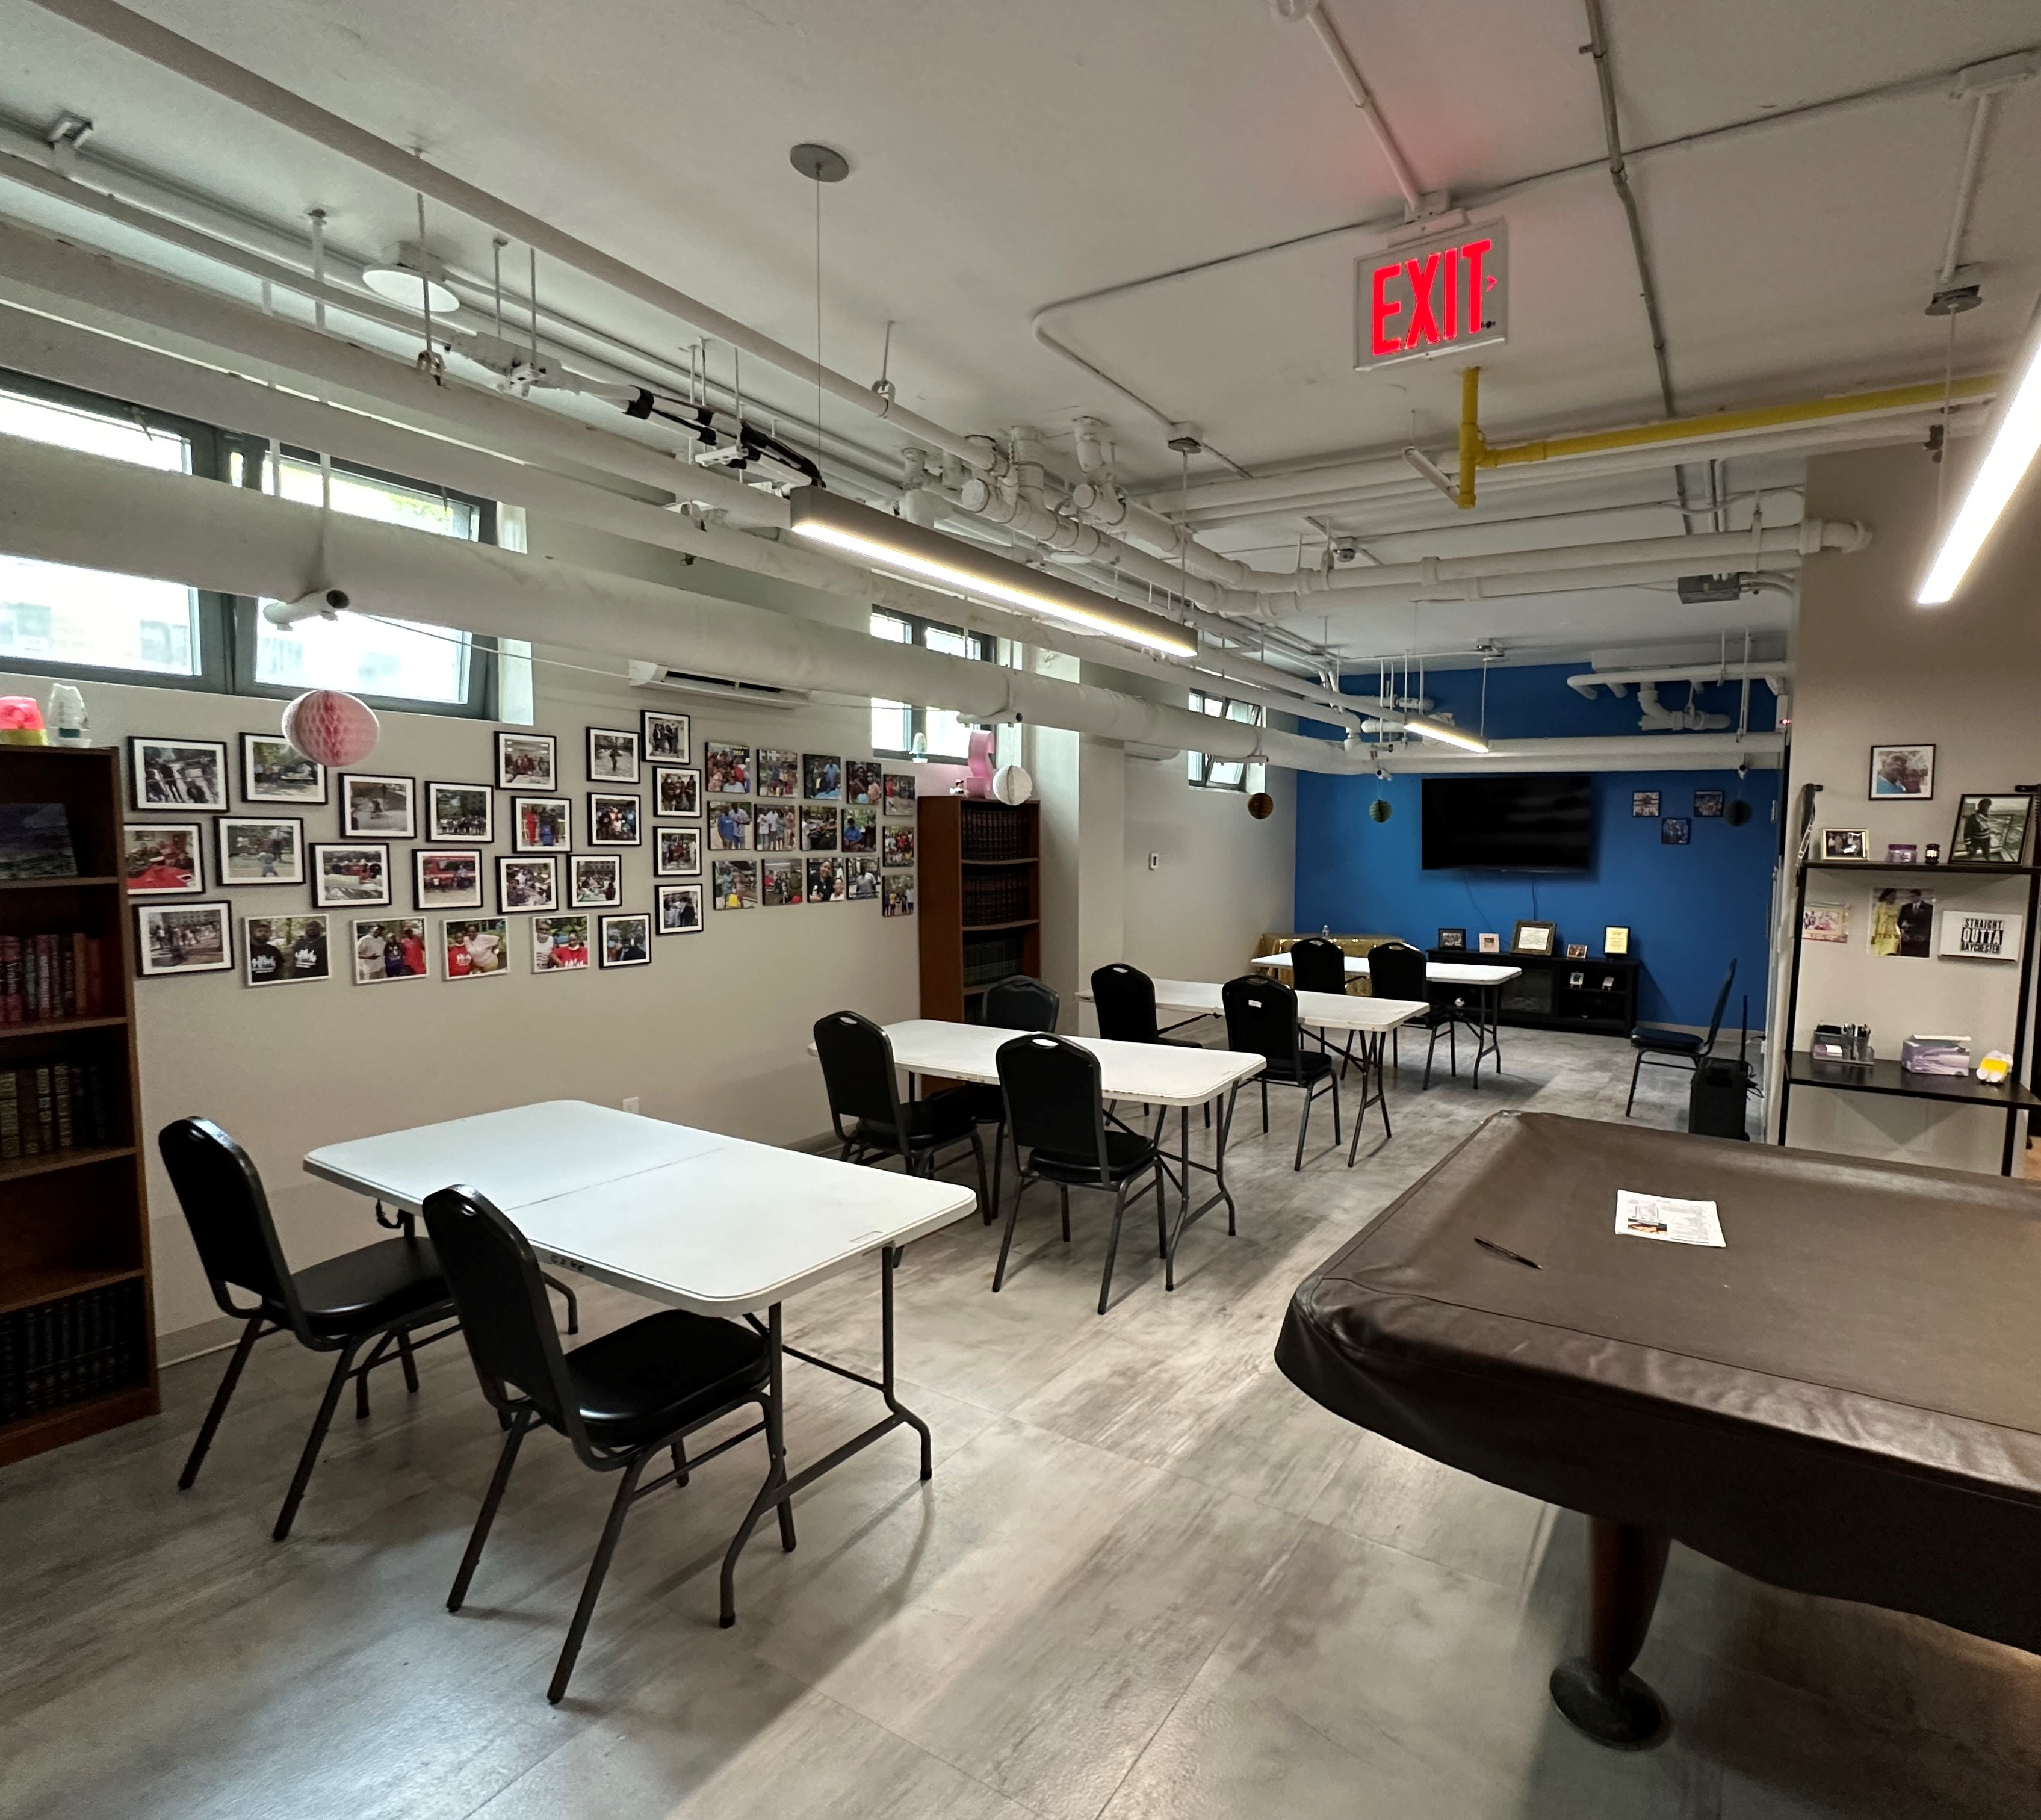
Future Voting: Community Rooms
Potential ideas for discussion:
computer lab, senior center, teen center, lending library, TA Lounge, more?
Baychester Houses TA office common kitchen
Baychester Houses TA office meeting space
Other Ideas?
We will build a platform to gather ideas and consensus from the entire
Linden Plaza community.

Slide 22
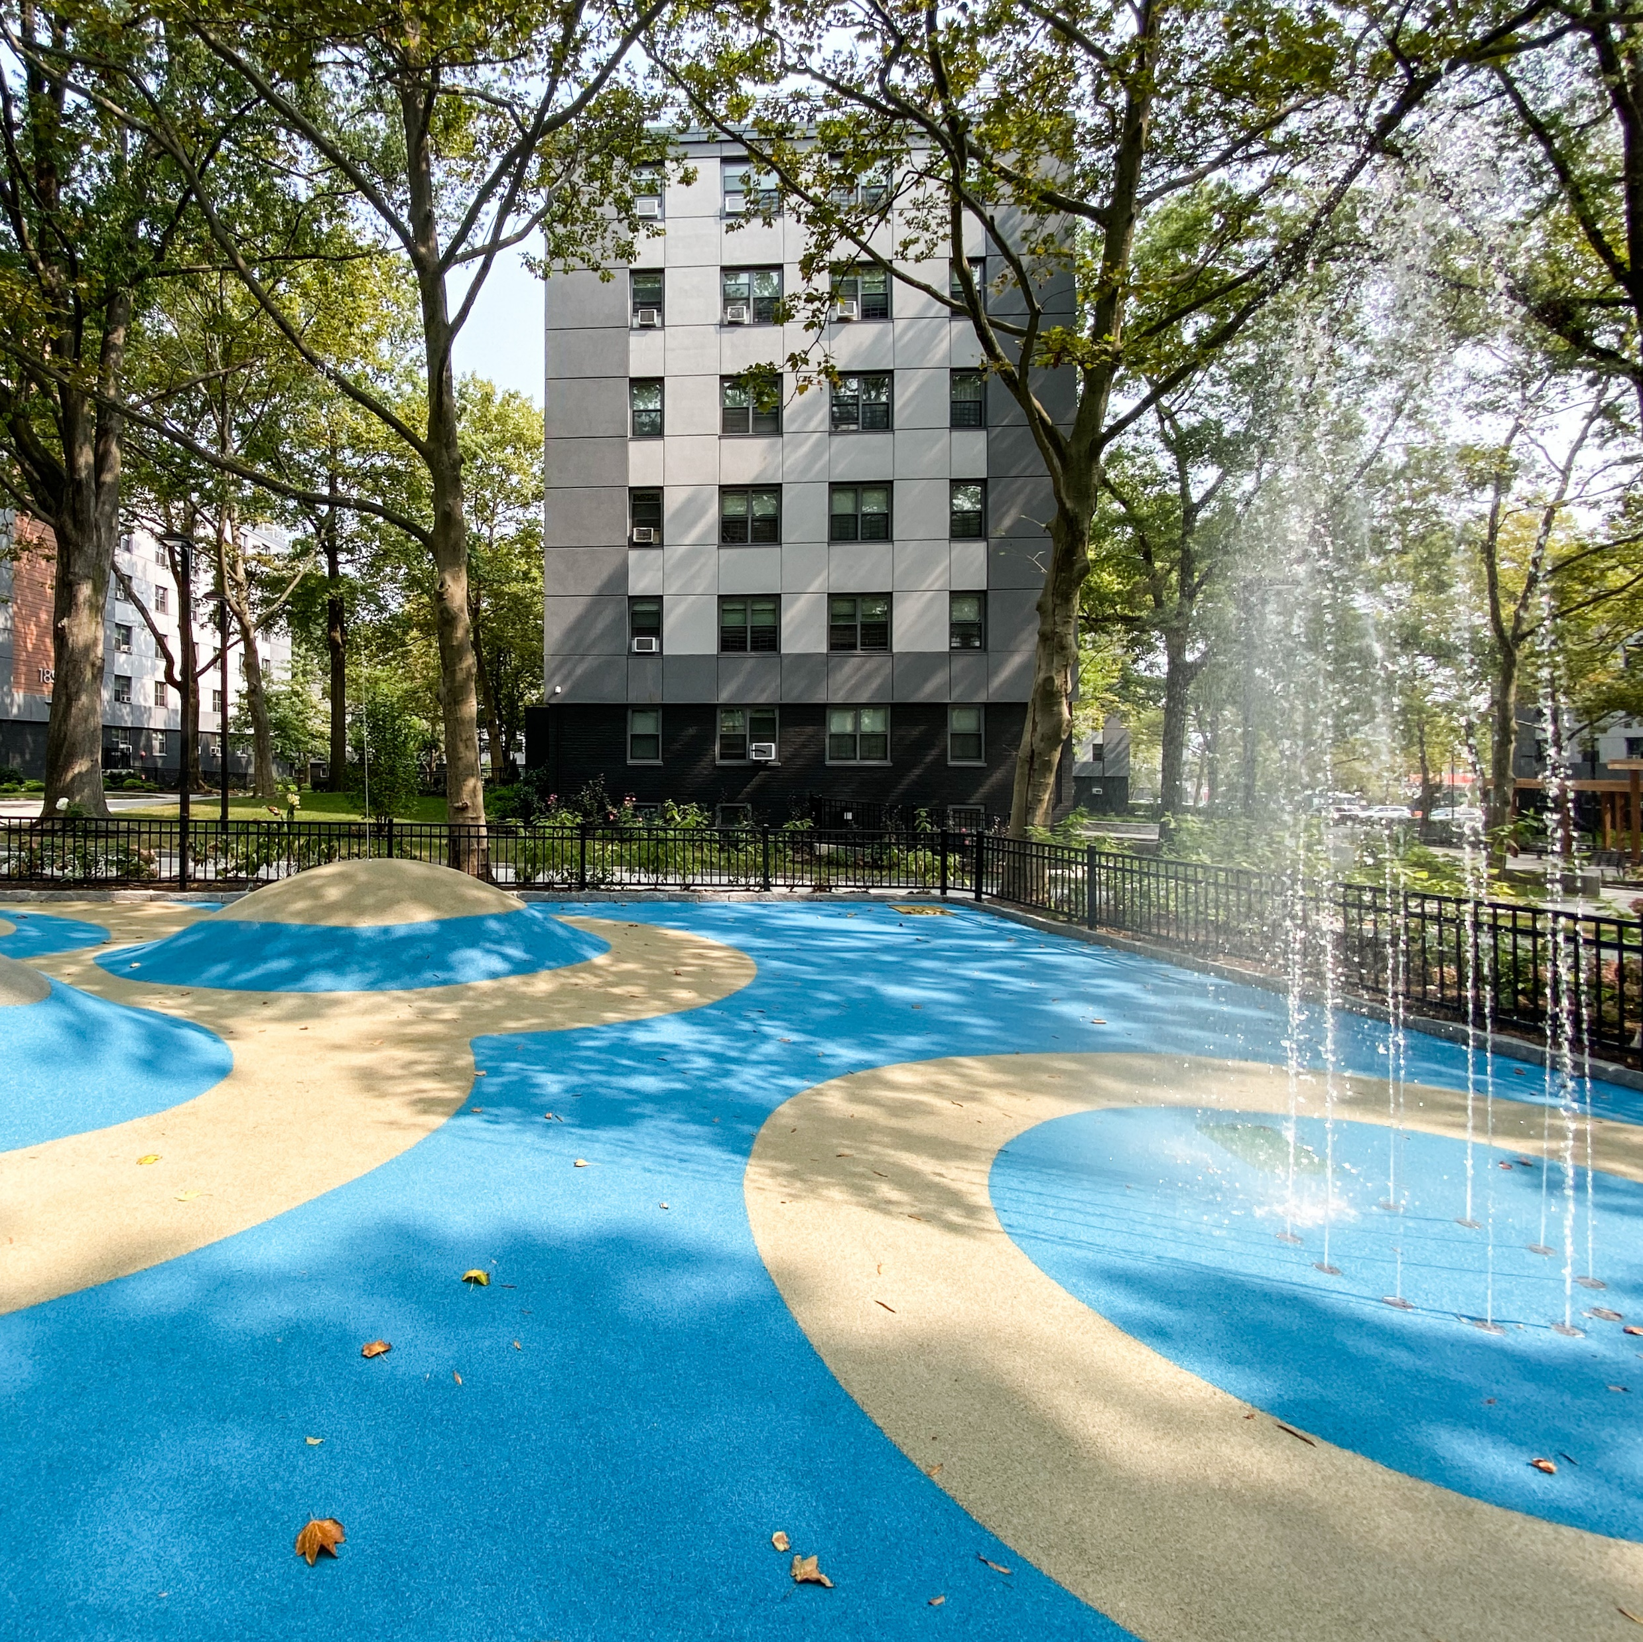
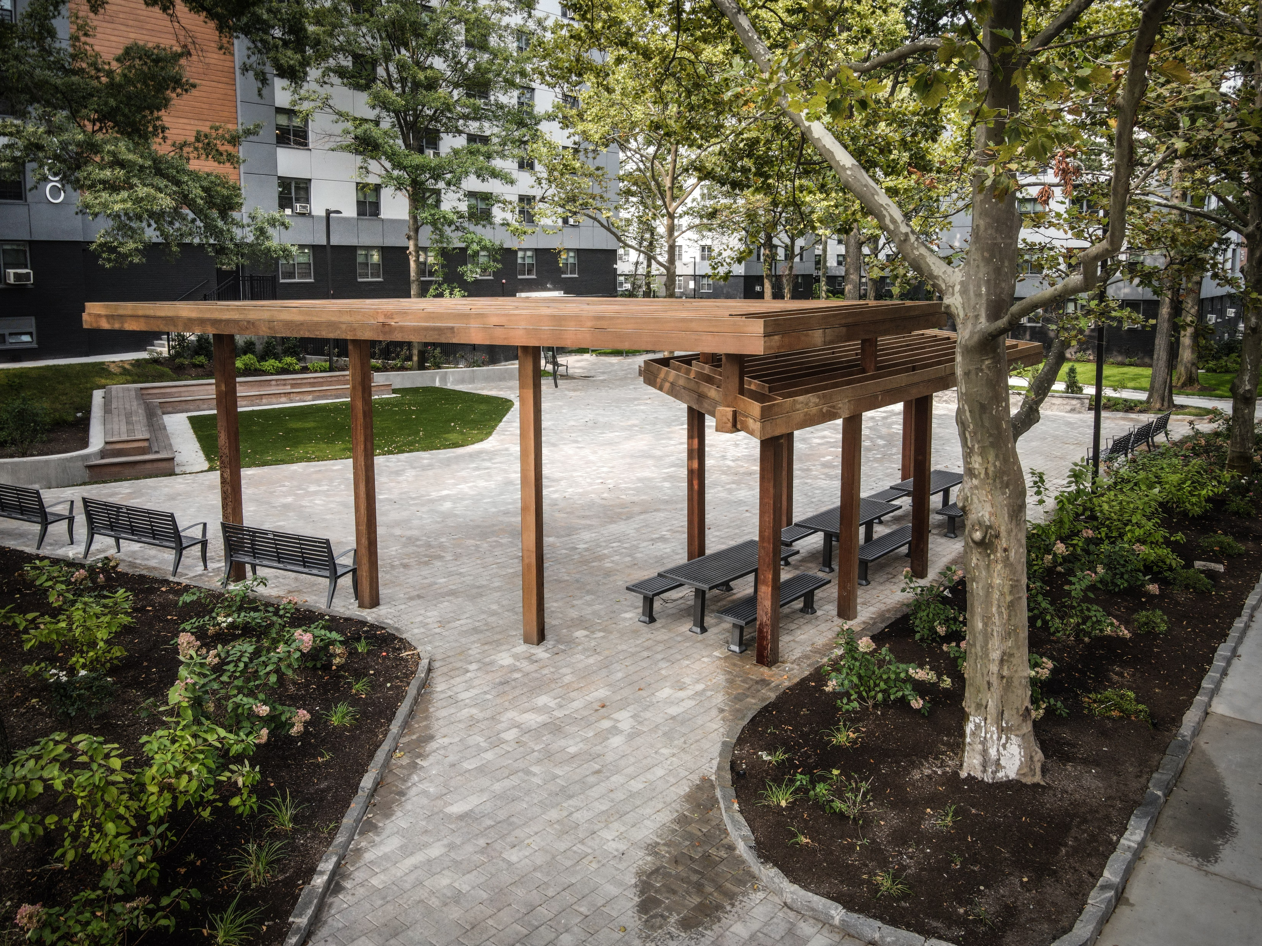
Future Voting: Pool Deck
Potential ideas for discussion:
basketball court, outdoor fitness area, outdoor performance space, more?
Baychester Houses outdoor play area
Baychester Houses outdoor meeting area
Other Ideas?
We will build a platform to gather ideas and consensus from the entire
Linden Plaza community.

Slide 23
6: Next Steps

Slide 24
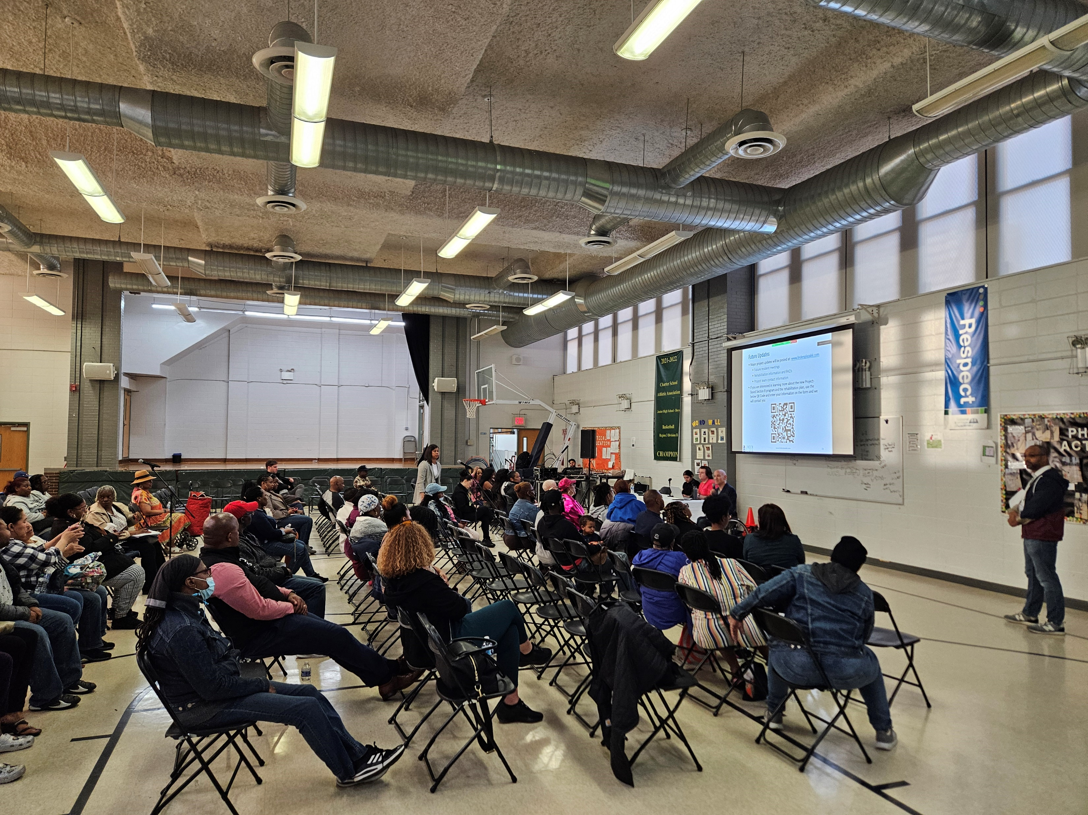
Next Steps
Upcoming resident meeting topics:
  Preparing for Temporary Relocation
  Preparing for Construction and Ownership Transition
Continue PBV unit conversions with HQS and certifications
Hold smaller meetings with each building to discuss specific issues
Survey households for temp relocation needs

Slide 25
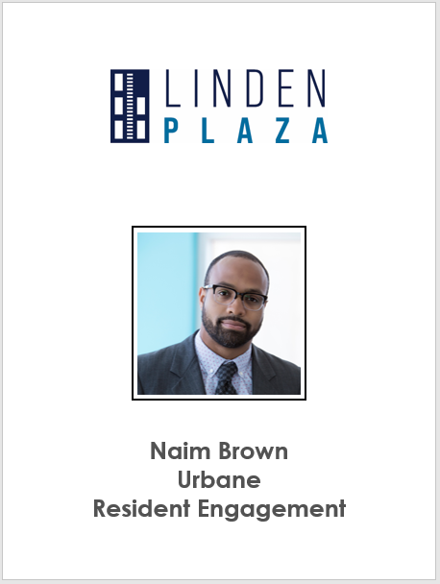

Example Badges

Slide 26

Future Updates
Major project updates will be posted at: www.lindenplazabk.com
  Future resident meetings
  Rehabilitation information and FAQ’s
  Project team contact information
If you are interested in learning more about the new Project-Based Section 8 program and the rehabilitation plan, use the below QR Code and enter your information on the form and we will contact you

Slide 27
Thank You!

