Slide 1

Resident Meeting #5
December 12th, 2024
Para Espanol:
Dial: 646 558 8656
ID: 497 692 7129

Slide 2
Resident Meeting #5
Agenda
  Review of Budget Based Rent Increase (BBRI)/Commissioner’s Order
  Management Transition
  Renovation Details
  PBVs Still Available for Qualifying Households
  Temporary Moves
  Next Steps

Slide 3
1: Review of September’s BBRI Meeting

Slide 4
The Rent Increase will not Impact any Current Resident at Linden Plaza
  In collaboration with HPD, HDC, lenders and historic tax credit equity investors, the new ownership is working on the rent structure to solidify the future financial standing of Linden Plaza.
  The plan provides for no increase in rents for current Linden Plaza unassisted households.

Slide 5
  A BBRI is a mechanism that allows owners of Mitchell-Lamas to keep up with rising costs of running a property in NYC
  BBRI stands for Budget Based Rent Increase.
  The residents of an Article 2 Project have the right to view the calculations and assumptions behind a BBRI.
  To facilitate the impending financing of Linden Plaza a BBRI will be posted to go into effect upon the Project changing ownership.

Slide 6
The BBRI has No Impact to Section 8 Residents
  For tenants with a rent subsidy (ex., Sec. 8, SCRIE and DRIE): Tenants continue to pay their tenant’s portion of the rent. Any increase that is reflected on the rent statements will be paid by the subsidy and not by the tenants.

Slide 7
2: Management Transition

Slide 8

  LP Preservation LLC will be taking over ownership of Linden Plaza this Month!
  New ownership has hired GRC Management as the new property manager for Linden Plaza to support the Linden Plaza community on day one.
GRC has substantial experience managing comparable properties in New York City.
GRC provides a full suite of property management services and has been hired by LP Preservation LLC because of its dedication to the resident first.

Slide 9
The team can leverage buying power and existing contracts to provide quick and affordable services to Linden Plaza Residents.
GRC’s Technical Services Department has over the past ten years overseen and supervised hundreds of millions of dollars in major capital improvement projects.
Mission Statement
Empower the team to deliver best in-class service to the owners and communities entrusted to us.
--
Our dual approach ensures communities and owners receive quality services and care because at the foundation of a good development is the residents’ quality of life and how we support the broader communities in which our properties reside.

Slide 10
  Linden Plaza: New Ownership Priorities
  Immediate Priorities:
  Address deferred maintenance across the ENTIRE property and reactivate suspended vouchers
    Prioritize life-safety repairs
    Address outstanding work orders
    Correct outstanding violations
  Recertify all residents
  Begin renovations in Building 5
    How will this be accomplished?
    Build a robust maintenance staff
    Hire a new leasing and compliance team
Residents will
NOT
be charged for repairs, work orders, or renovations.
Notes:
No one’s rents will increase – there will be relocation – correct mold and heat and long-term cure of the “implorable” conditions – reassure anxiety about relo – disabled and senior population
Add note about current conditions and goals to improve
Dps – two admin, two compliance, leasing and compliance manager is

Slide 11
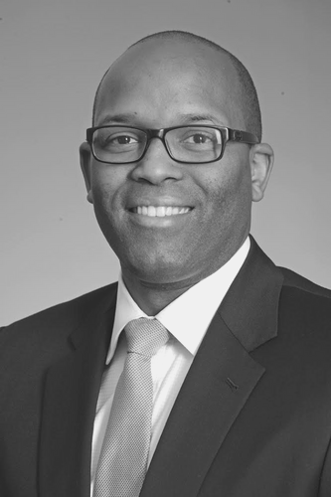

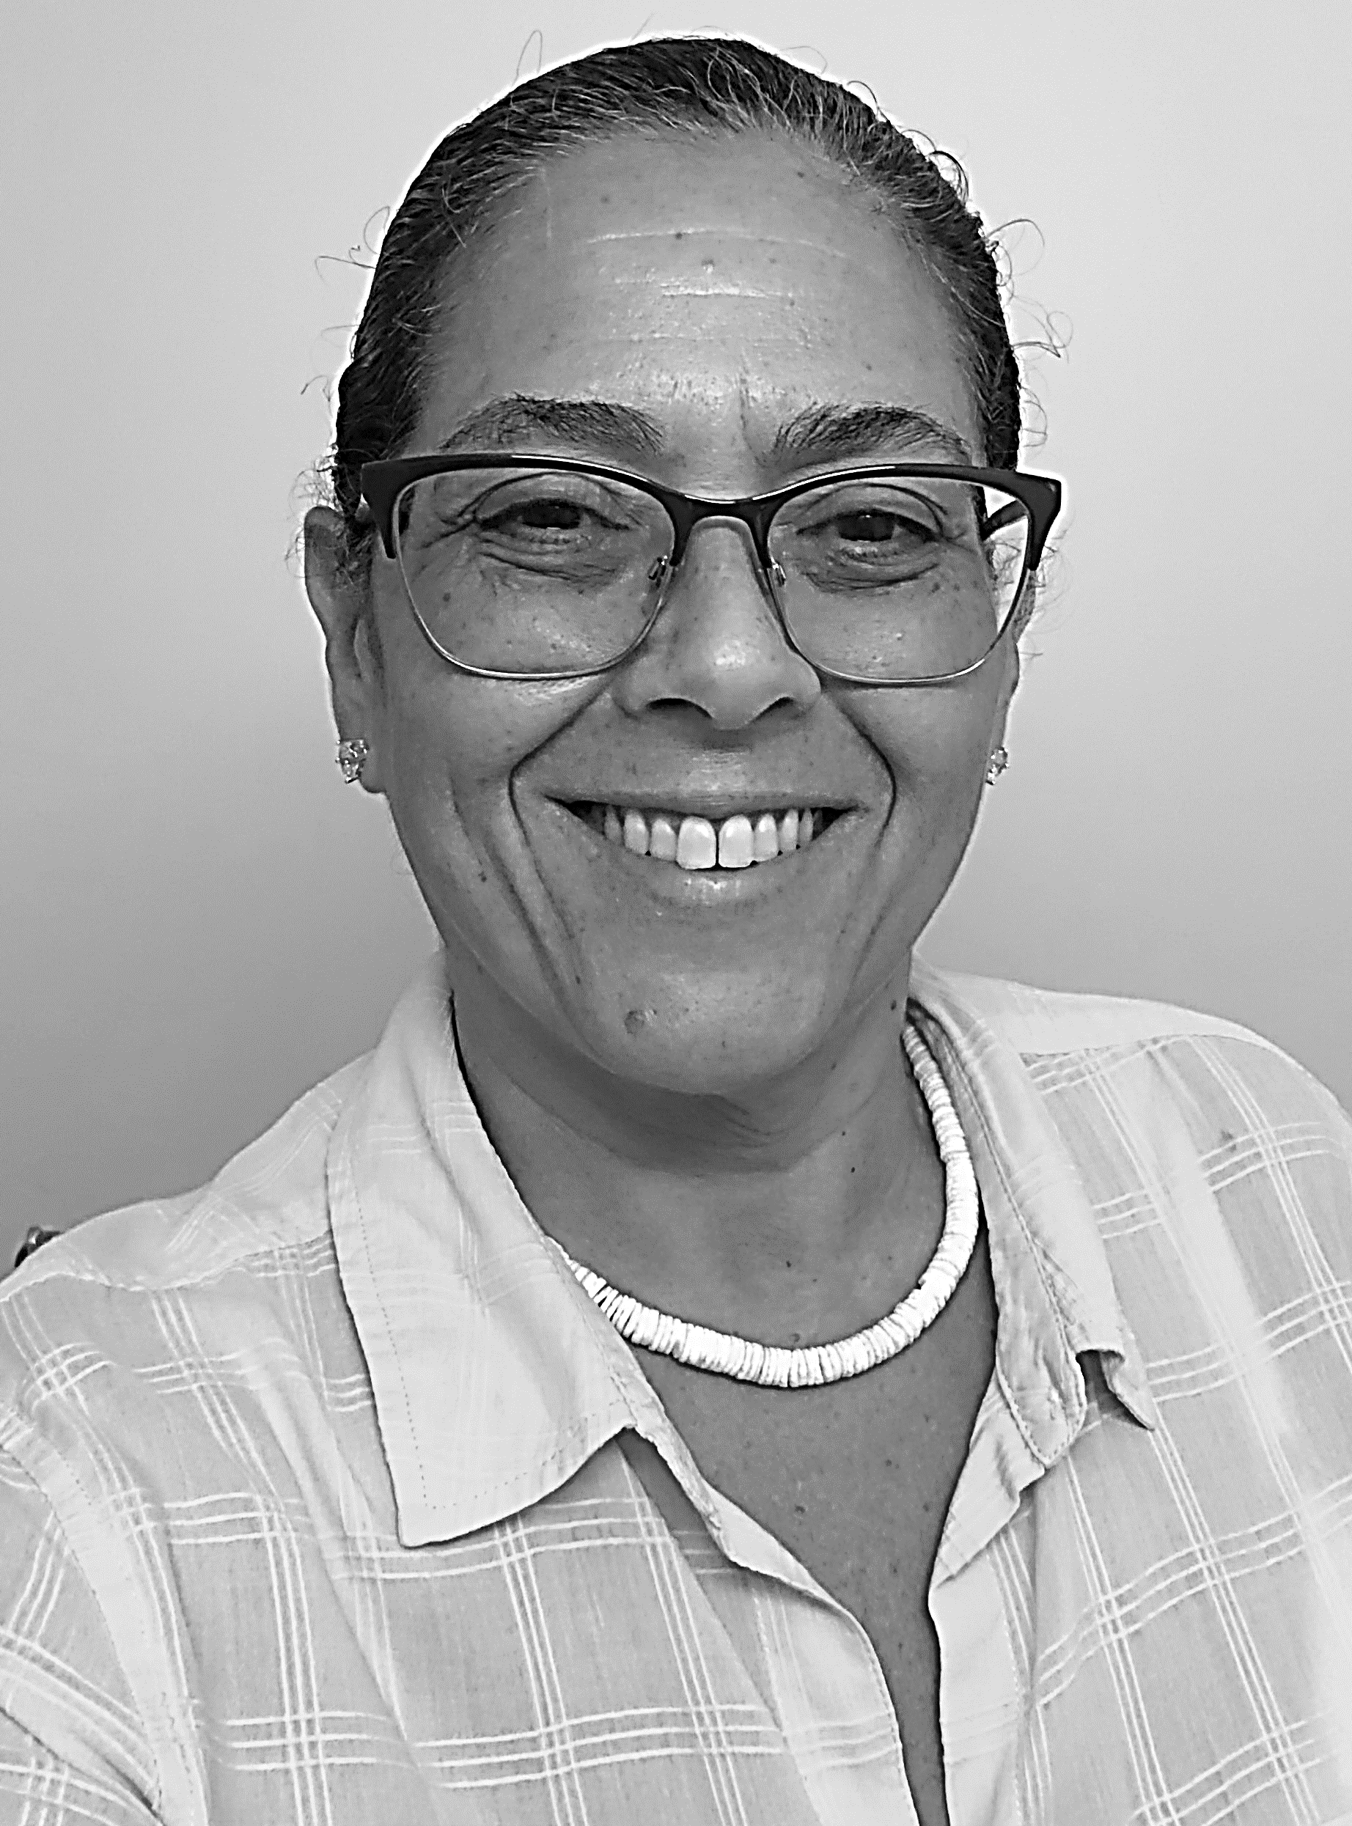

Your Management Team
Ryan Moorehead
President & CEO
Warren Harr
Director, Operations
Rose Santo
General Manager
Rod Robertson
Director, HR

Slide 12



How to Contact GRC for Maintenance Requests
    Email
    Phone
    RENT CAFE
    Management Office Hours and Location: 8 AM to 5 PM
      Temp Office will be located in 782 Eldert Lane TH across from Building 2
    Residents will be able to use RentCafe App to submit work orders

Slide 13


How to Pay Rent (beginning January 2025)
    Mail a Check or Money Order
    Online via RentCafe App
    LP Preservation HTC LLC
    P.O. Box 25044
    New York, NY 10087-5044
    Detailed instructions to be provided in January Rent Bills
    Check or Money orders should be made payable to LP Preservation HTC LLC.
    Rent is due the 1st of each month.
    Rental payments will not be accepted at the property management office.

Slide 14
How to Pay Rent (beginning January 2025)
    Online via RentCafe App
    **10 x 10 Incentive Program**
    Any resident that signs up for RentCafe and pays their rent in full via RentCafe by the 10th day of the month, will receive a $10 rent credit toward next month rent.
    Ex) Your rent is $700 per month. You pay your $700 rent on January 4th. You will receive a $10 rent credit on your February rent bill.
    Events will be scheduled by the Linden Plaza management team to assist residents in signing up for Rent Café.

Slide 15
Rent Policies
  The Compliance Team will work with residents on annual lease signings, voucher recertification, and suspended vouchers due to certification issues.
  Appliance and parking charges will remain the same.
Notes:
Acknowledge issues with lost subsidies and rent increases
System in place to make sure this doesn’t happen. - coordination around compliance – Wavecrest with strong experience in these topics

Slide 16
House Rules
  No personal items such as bicycles, garbage, recycling, etc. shall be allowed in public halls.
  Reasonable accommodations for pets will continue.
  No smoking inside any building at Linden Plaza.
  Only the residents listed on your lease agreement are permitted to live in your apartment home. In accordance with HUD regulations and your lease, you must obtain written prior consent of the landlord to add additional household members to your lease.
  All residents are permitted to have visitors and/or houseguests. However, guests that stay for more than 10 consecutive days may be considered illegal occupants and may be subject to legal action. All residents are responsible for the actions of their visitors/houseguests.
Notes:
Acknowledge issues with lost subsidies and rent increases
System in place to make sure this doesn’t happen. - coordination around compliance – Wavecrest with strong experience in these topics

Slide 17
House Rules – Crime Free Policy
  Residents, any members of the resident's household, or a guest or other persons affiliated with the resident:
  Shall not engage in criminal activity, including drug-related criminal activity, on or near the premises.
  Shall not engage in any act intended to facilitate criminal activity.
  Shall not permit the apartment to be used for, or to facilitate criminal activity, regardless of, or whether the individual engaging in such activity is a member of the household or a guest.
  Shall not engage in the unlawful manufacturing, selling, using, storing, keeping, or giving of an illegal or controlled substance, at any locations, whether on or near the apartment premises.
Notes:
Acknowledge issues with lost subsidies and rent increases
System in place to make sure this doesn’t happen. - coordination around compliance – Wavecrest with strong experience in these topics

Slide 18
3: Renovation Details

Slide 19






Renovation Work Will Take Place Over
At Least Four Years
Today - Closing:
PBV HQS, ERP Repairs, Household Certifications, and Apartment Surveys
2025 – 2029
Temp Relocation and Full Project Renovation
Q4 2024 Closing: Management Transition
Commence rehab work following financing
Apartment upgrades, landscaping, and improvements to major building envelope, systems and common areas
In order to complete the renovations safely, fully, and on time, the GC must work in one building at a time. Building 5 will be renovated first. The order of remaining high rises is 1, 2, 4, and 3. Town homes will be renovated around the time of the high rise immediately parallel to them starts.

Slide 20
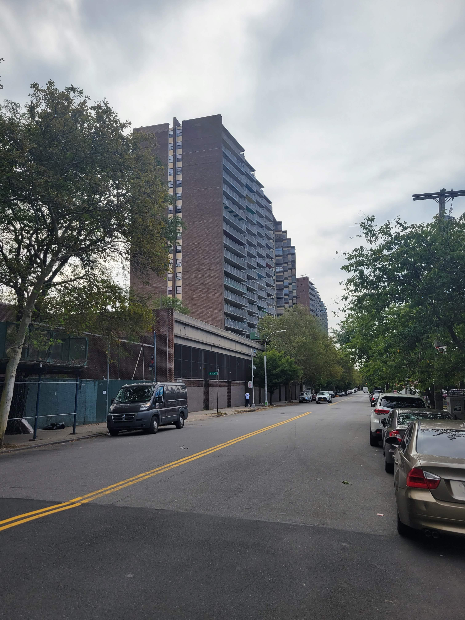
Renovations: Proposed Scope of Work
Comprehensive scope of work will provide long-lasting cures to decades-old conditions
In-unit renovations: New Kitchen, New Bathroom, New Flooring, and Painting
Building Envelope: Repairs to façade, roof and areas of water infiltration
Balconies: Railing and divider repairs, waterproof concrete
Plumbing: Full replacement of risers to prevent future leaks and mold
Heating: Repairs to heat plant and distribution
Structure: Repairs to concrete
Section 504: Improve accessibility conditions for disabled residents and allow seniors to age-in-place

Slide 21
4. PBVs Are Still Available for Qualifying Households

Slide 22
Project-Based Vouchers (PBVs)
  A limited amount of new Project-Based Section 8 Vouchers (PBVs) will be offered.
  Linden Plaza residents who qualify will pay the lesser of 30% of their adjusted gross household income or the existing Mitchell-Lama rent for your unit towards rent.
  Benefits Include:
    Rent payments sized on 30% of your income on rent.
    If you decide to move after 1 year, you can apply for a portable housing voucher.
    Unit will undergo HQS repairs and inspection prior to subsidy starting.
      HQS repairs can provide immediate benefits to your apartment before the eventual renovations (especially if you are not in the first phase).
Notes:
Acknowledge issues with lost subsidies and rent increases
System in place to make sure this doesn’t happen. - coordination around compliance – Wavecrest with strong experience in these topics

Slide 23
Do You Qualify for Project-Based Vouchers?
  To qualify for PBVs, households must:
    Income certify
    Pass Housing Quality Standards (HQS) physical inspections
    Maintain a rightsized unit per HUD standards
Notes:
Add right sizing table

Slide 24
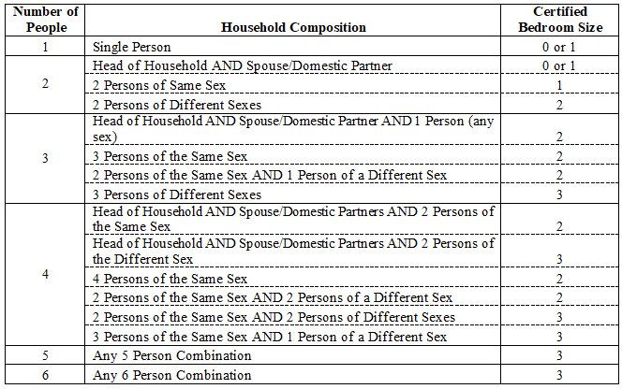
For PBV Applicants: Rightsizing
Your unit must also be rightsized. That means that your apartment’s household composition meets one of the breakdowns listed below. Note, if you are not currently rightsized, we can work with you to move you and your household into a correctly sized unit within Linden Plaza.

Slide 25
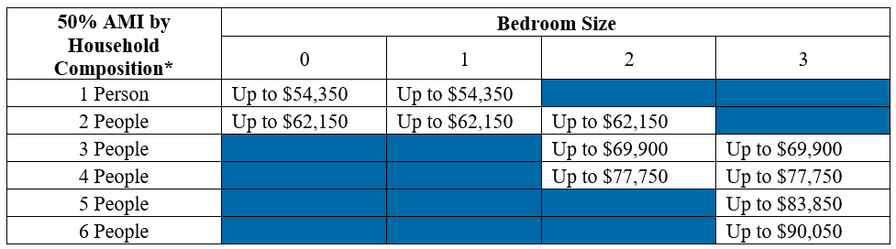
For PBV Applicants: Income Qualifying
  Your current income must be less than 50% of the Area Median Income (“AMI”). Your AMI varies based on the number of residents in your apartment. A breakdown of those AMI’s are below.

Slide 26
Unsure if you qualify?
  Talk to Urbane, who are attending today’s meeting, to see if you qualify! They can answer any questions you may have about the program.
Notes:
Add right sizing table

Slide 27
5: Temporary Moves

Slide 28
Building 5 Will Temporarily Move First
  Complete your household Move Assessment
  Prepare for a Pest Inspection
  Attend a “drop-in” Moving Prep session
    Weekly sessions on Friday mornings at 11:30 am, starting November 1, 2024
    Monthly Saturday sessions, every second Saturday of the month, starting November 16, 2024
  Sign-up for Dumpster Day for assistance removing bulky items/furniture
    You will be required to sign a Trash Disposal Form detailing those items you want thrown away
    Document shredding will be available on Dumpster Day
  Make arrangements to obtain packing materials and packing tip sheet
Notes:
Add right sizing table

Slide 29
How to prepare for your upcoming move
  Schedule appointment for inventory of apartment belongings
  Start packing or notify HOU if you require packing assistance
  Schedule transfer of in-home services and utilities (cable, Internet and phone)
    Notify HOU of any outstanding utility balance to ensure seamless transfer of utilities
  Notify HOU of any planned extended absences from apartment (vacations, medical procedures)
  Sign Temporary Move Agreement or One-Way Voluntary Move Agreement
  If unable to be present on your move day, complete a “move day proxy” form identifying a responsible adult who will be present
Notes:
Add right sizing table

Slide 30
6: Next Steps

Slide 31
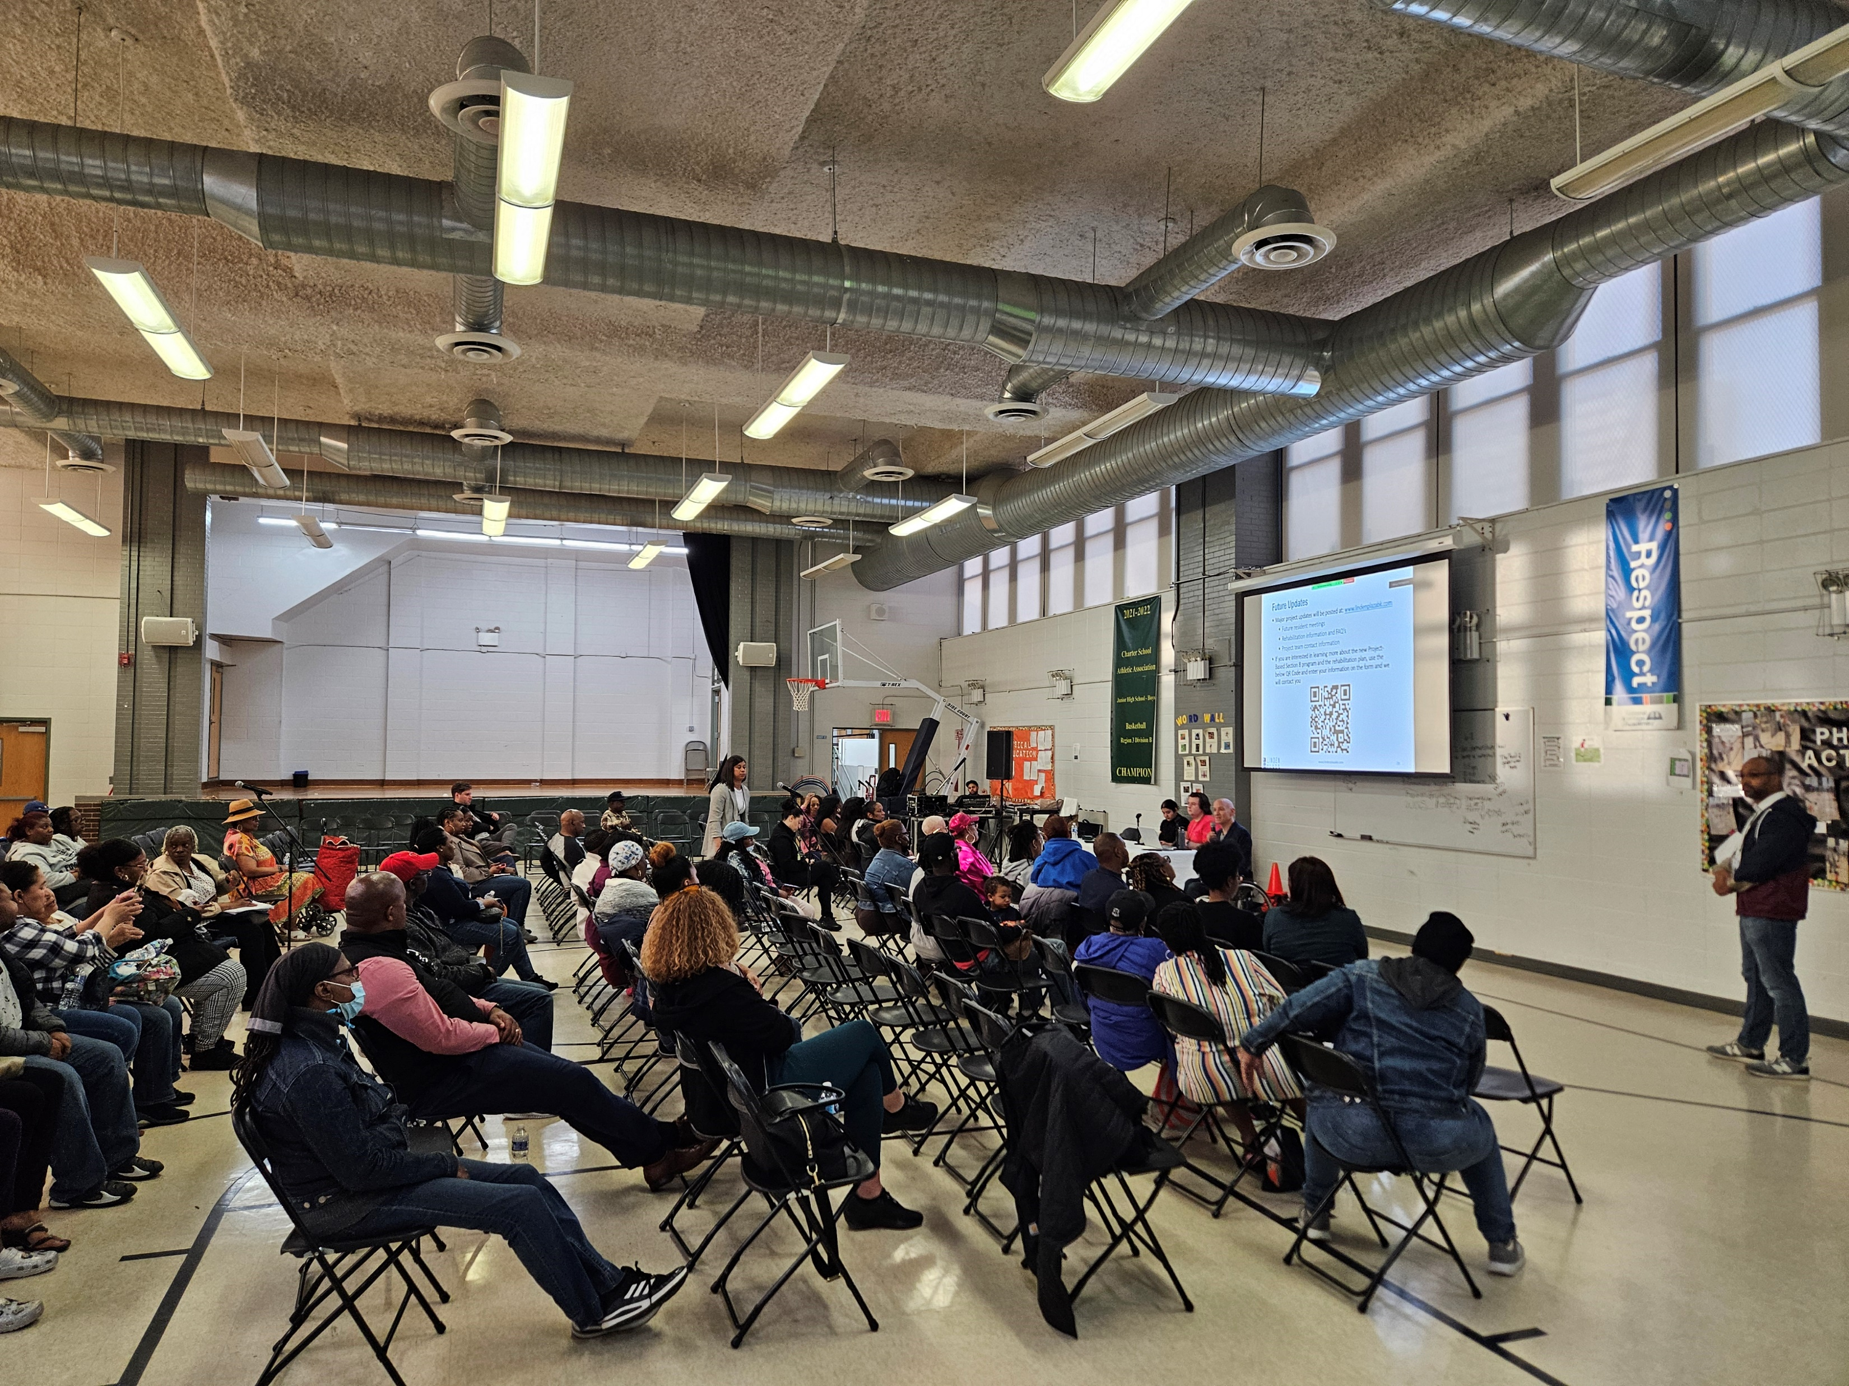
Next Steps
Transition ownership of Linden Plaza!
Upcoming resident meeting topics:
  Preparing for Construction
Continue PBV unit conversions with HQS and certifications
Look for the Rent Concession Agreement in the Mail
Sign the Rent Concession Agreement after review
Reach out to us with any questions
If you think you are eligible for a PBV, reach out to us

Slide 32
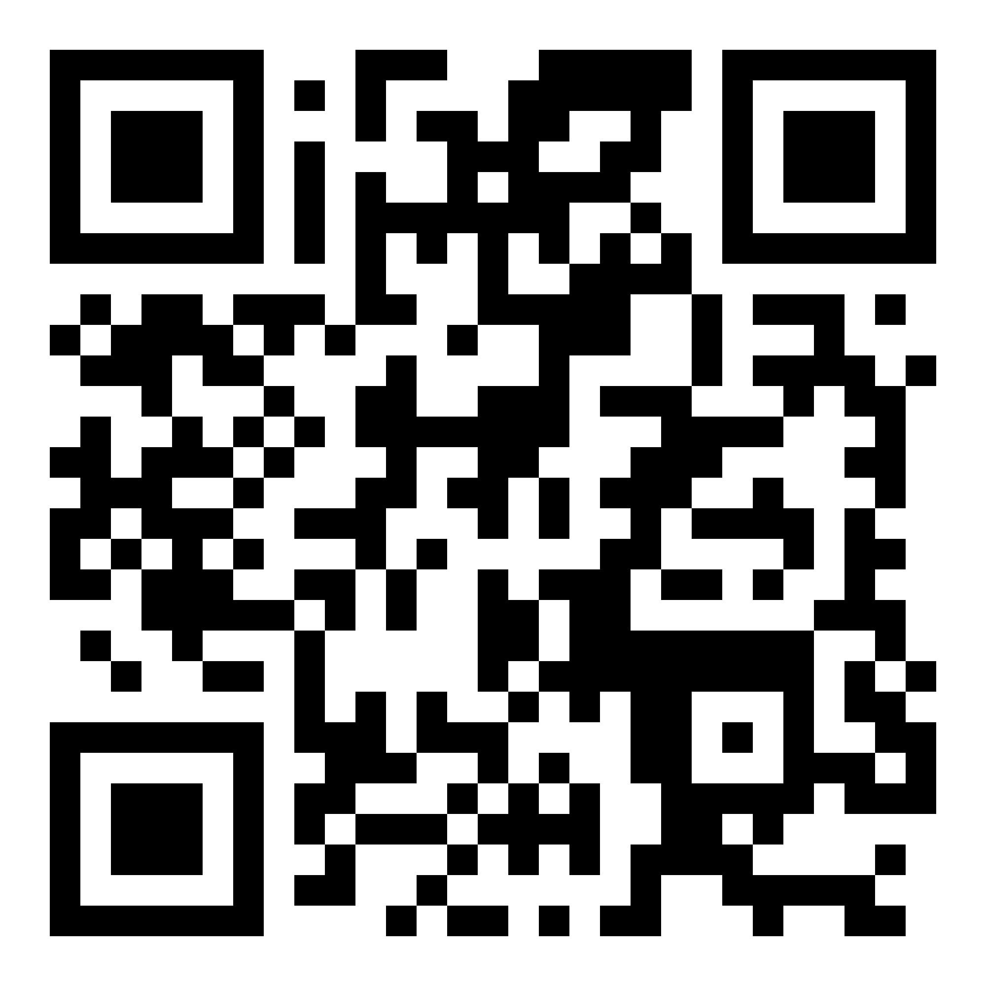
Future Updates
Major project updates will be posted at: www.lindenplazabk.com
  Future resident meetings
  Rehabilitation information and FAQ’s
  Project team contact information
If you are interested in learning more about the new Project-Based Section 8 program and the rehabilitation plan, use the below QR Code and enter your information on the form and we will contact you

Slide 33
Thank You!

