Slide 1
Resident Meeting #6 March 19, 2025
Para Espanol:
Dial: 646-558-8656
ID: 522 498 0218

Slide 2
Resident Meeting #6
Agenda
Ownership & Management Introduction
Operations Update
Rent Payments
Compliance Update
Parking
Construction Update
Next Steps

Slide 3
1: Ownership & Management Introduction

Slide 4
LP Preservation LLC took over ownership of Linden Plaza at the start of the year.
New ownership has hired GRC Management as the new property manager.
GRC has substantial experience managing comparable properties in New York City.
GRC provides a full suite of property management services and has been hired by LP Preservation LLC because of its dedication to the resident first.

Slide 5
Site Staff: Property Management and Operations Location: 675 Lincoln Avenue Ground Floor Office
General Manager: Rose Santo
Property Manager: Tina White
Director of Maintenance: Steve Schor
Administrative Assistants: Angelikah Freeman and Sindy Hernandez
Supers:
Building 5 Charles Williams
Building 4 John Cassar
Building 3 John C and Charles
Building 2 Tiffany Henry
Building 1 John Robinson
Contact Maintenance:
(718) 540-4299 Opt 1

Slide 6
Site Staff: Compliance Office Location: Bldg 5. Mezz Level (past laundry room)
Compliance Manager: Wafa Edolsky
Compliance Specialists:
Bashar Mohamad
Hamdy Abdelwahab
Mina Nashed
Administrative Assistant:
Brittney Martin
For Questions on:
Leases, LIHTC documents, PBV Section-8, TBV documents (NYCHA, HPD, CVR), Rent & Billing
Contact Compliance:
(718) 540-4299 Opt 3
Building 5 Compliance Office

Slide 7
Social Services: 760 Eldert Lane, 11S Mylah’s Organization
Key Personnel
Michael Rosendary
Kenny Perry
Ricky Michael
Moncayo Robalino
Johnny Garcia
Joshua Baldwin
Marvelline Richard
Providing Referral Services and other Social Service support
Contact Mylah’s:
(347) 329-8792
LindenPlazaSocialService@gmail.com
760 Eldert Lane, 11S

Slide 8
Site Security Reliant and Madison
Key Personnel
Danny Cunningham (Reliant)
Angel Gonzalez (Reliant)
Jamal Williams (Madison)
For life threatening emergencies call 911
Contact Security:
(718) 540-4299 Opt 4

Slide 9
Relocation: 760 Eldert Lane, 13L Housing Opportunities Unlimited
Contact HOU:
(347) 384-6043
lindenplaza@housingopportunities.com
760 Eldert Lane, 13L
Key Personnel
Noelle Zeppa
Quan Reid-Smith
Starr Quick
Jasmin Olmo
Adiel Vasconez
Omar Ocampo
To Contact Relocation Team call 347-384-6043
For questions about your temporary relocation and any updates related to your move date.

Slide 10
2: Operations Update

Slide 11
Linden Plaza: Ownership & Management Priorities
Immediate Priorities:
Address deferred maintenance across the ENTIRE property and reactivate suspended vouchers
Prioritize life-safety repairs
Address work orders
Correct outstanding violations
Recertify all residents
Begin renovations in Building 5
Residents will
NOT
be charged for repairs, work orders, or renovations.
Notes:
No one’s rents will increase – there will be relocation – correct mold and heat and long-term cure of the “implorable” conditions – reassure anxiety about relo – disabled and senior population
Add note about current conditions and goals to improve
Dps – two admin, two compliance, leasing and compliance manager is

Slide 12
Completed Work to Date
Deep Cleaning complete at common areas of 3 buildings and will continue
Over 1,300 work orders closed out
There will continue to be issues at the property and we urge you to call us with emergency and be patient
718-540-4299 Maintenance closed from 12PM – 1PM for lunch
Deep Cleaning and Work Orders Resolved
Notes:
No one’s rents will increase – there will be relocation – correct mold and heat and long-term cure of the “implorable” conditions – reassure anxiety about relo – disabled and senior population
Add note about current conditions and goals to improve
Dps – two admin, two compliance, leasing and compliance manager is

Slide 13
How to Contact Management
Phone
Email
718-540-4299
Option 1: Maintenance
Option 2: Management Office
Option 3: Recertifications
Option 4: Security
Option 5: Relocation/HOU
Option 6: General Questions
hello@lindenplazabk.com
The Property Management Office is located at 675 Lincoln Avenue on the ground floor. The office is open Monday – Friday (9:30am- 4pm) for walk ins. Closed for lunch from 1pm-2pm
Residents can use the RentCafe App to submit work orders

Slide 14
3: Rent Payments

Slide 15
How to Pay Rent
Mail a Check or Money Order
Online via RentCafe App
LP Preservation HTC LLC
P.O. Box 25044
New York, NY 10087-5044
Please contact the property management team to get signed up for Rent Cafe
Check or Money orders should be made payable to LP Preservation HTC LLC
Rent is due the 1st of each month
Rental payments will not be accepted at the property management office

Slide 16
How to Pay Rent – Online via Rent Cafe
**10 x 10 Incentive Program**
$10 rent credit if rent paid through Rent Café by the 10th day of the month
Ex) Your rent is $700 per month. You pay your $700 rent on January 4th. You will receive a $10 rent credit on your February rent bill.
Credit card fees apply, no fees with payments through your bank account –ROUTING INFO FOR NO CHARGE
Please reach out if you need assistance registering for Rent Café.

Slide 17
Rent Billing and Questions
All arrears and credits from prior ownership will be included in the April rent bills
If there are questions regarding your specific rent bill please visit the property management office to discuss
AC charges will continue to be listed on rent bills. If you do not have an AC but are being charged, please put in a work order with maintenance to confirm
Parking will be charged separately through LAZ Parking a third-party operator
Notes:
Acknowledge issues with lost subsidies and rent increases
System in place to make sure this doesn’t happen. - coordination around compliance – Wavecrest with strong experience in these topics

Slide 18
4: Compliance Update

Slide 19
New Leases and Rent Concession Agreement
All residents will sign new leases
The new lease will have a House Rules Rider
A Commissioner’s Order for the new Mitchell-Lama Rent will be posted. Unassisted units can protect current Mitchell-Lama rent by signing a Rent Concession Agreement, distributed to unassisted units
Notes:
Acknowledge issues with lost subsidies and rent increases
System in place to make sure this doesn’t happen. - coordination around compliance – Wavecrest with strong experience in these topics

Slide 20
Upcoming Compliance Initiatives
All residents in LIHTC units will need to self certify for 2024 and 2025
Your specific package of documents will be delivered to your unit in the coming weeks. Please review and complete.
Unlike prior certifications this process is simpler with less paperwork
If you need assistance completing your compliance package reach out to the compliance team.
Project Based Voucher registration

Slide 21
5: Parking

Slide 22
Parking at Linden Plaza
LAZ Parking will be the parking garage operator
Priority parking at Linden Plaza is for Linden Plaza residents. Beginning in April, any parked car that is not registered with management will be towed.
To apply for parking please reach out to LindenPlaza@LAZParking.com or 646-908-2230. Applicants will need to have:
A valid photo ID with a Linden Plaza address
Updated vehicle registration with Linden Plaza Address
Vehicle Insurance

Slide 23
Temporary Parking Lot Closures
During construction, there will be lots that are closed for critical repairs, starting with the L-shaped Lot #5
Alternative parking will be provided to residents on a first come first served basis.
Lot 5 (the lot in front of 675 Lincoln Avenue) will be closed starting on April 10th

Slide 24
6: Construction Update

Slide 25
Renovations: Proposed Scope of Work
Comprehensive scope of work will provide long-lasting cures to decades-old conditions
In-unit renovations: New Kitchen, New Bathroom, New Flooring, and Painting
Building Envelope: Repairs to façade, roof and areas of water infiltration
Balconies: Railing and divider repairs, waterproof concrete
Plumbing: Full replacement of risers to prevent future leaks and mold
Heating: Repairs to heat plant and distribution
Structure: Repairs to concrete
Section 504: Improve accessibility conditions for disabled residents and allow seniors to age-in-place

Slide 26
What to Expect During Construction?
Increased activity across the property, starting in building 5
Elevator delays and shutdowns
Safety protocols put in place to keep residents and workers safe
If there are any concerns during please reach out to property management

Slide 27
When will the construction work begin?
Work in Building 5 boiler room is underway
Unit work will commence in April for units that have successfully relocated to temporary units
Relocation is imperative for the succuss of the project. We are in this together
If you have questions about moving, please contact Housing Opportunities (HOU).
Each building will have their own move meeting. Look out for announcements!

Slide 28
7. PBVs Are Still Available for Qualifying Households

Slide 29
Project-Based Vouchers (PBVs)
A limited amount of new Project-Based Section 8 Vouchers (PBVs) will be offered.
Linden Plaza residents who qualify will pay the lesser of 30% of their adjusted gross household income or the existing Mitchell-Lama rent for your unit towards rent.
Benefits Include:
Rent payments sized on 30% of your income on rent.
If you decide to move after 1 year, you can apply for a portable housing voucher.
Unit will undergo HQS repairs and inspection prior to subsidy starting.
HQS repairs can provide immediate benefits to your apartment before the eventual renovations (especially if you are not in the first phase).
Notes:
Acknowledge issues with lost subsidies and rent increases
System in place to make sure this doesn’t happen. - coordination around compliance – Wavecrest with strong experience in these topics

Slide 30
Do You Qualify for Project-Based Vouchers?
To qualify for PBVs, households must:
Income certify
Pass Housing Quality Standards (HQS) physical inspections
Maintain a rightsized unit per HUD standards
Notes:
Add right sizing table

Slide 31
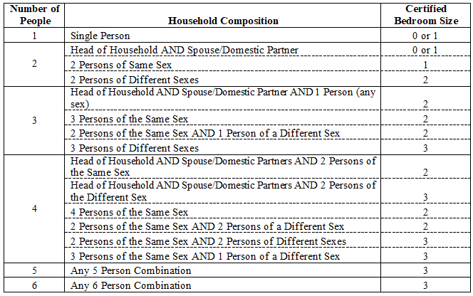
For PBV Applicants: Rightsizing
Your unit must also be rightsized. That means that your apartment’s household composition meets one of the breakdowns listed below. Note, if you are not currently rightsized, we can work with you to move you and your household into a correctly sized unit within Linden Plaza.

Slide 32
For PBV Applicants: Income Qualifying
Your current income must be less than 50% of the Area Median Income (“AMI”). Your AMI varies based on the number of residents in your apartment. A breakdown of those AMI’s are below.

Slide 33
Unsure if you qualify?
Talk to the compliance team, who are attending today’s meeting, to see if you qualify! They can answer any questions you may have about the program.
Notes:
Add right sizing table

Slide 34
8: Next Steps

Slide 35
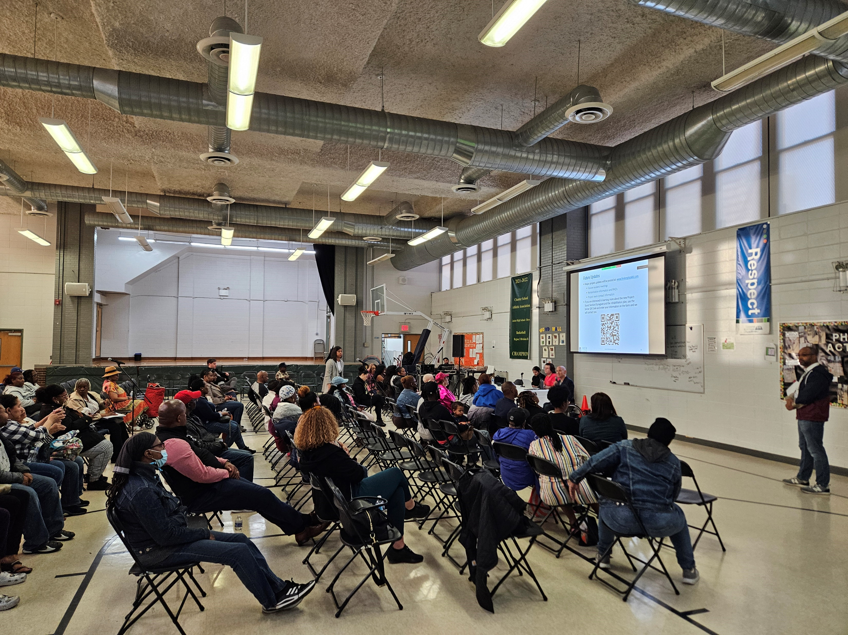
Next Steps
Begin construction in building 5 (675 Lincoln Ave)
Continue PBV unit conversions with HQS and certifications
Look for the Rent Concession Agreement and other compliance documents in the mail
Sign the Rent Concession Agreement after review
Reach out to us with any questions
If you think you are eligible for a PBV, reach out to us

Slide 36
Future Updates
Major project updates will be posted at: www.lindenplazabk.com
If you are interested in learning more about the new Project-Based Section 8 program and the rehabilitation plan, use the below QR Code and enter your information on the form and we will contact you
hello@lindenplazabk.com
718-540-4299

Slide 37
How to Contact Management
Phone
Email
718-540-4299
Option 1: Maintenance
Option 2: Management Office
Option 3: Recertifications
Option 4: Security
Option 5: Relocation/HOU
Option 6: General Questions
hello@lindenplazabk.com
The Property Management Office is located at 675 Lincoln Avenue on the ground floor. The office is open Monday – Friday (9:30am- 4pm) for walk ins. Closed for lunch from 1pm-2pm
Residents can use the RentCafe App to submit work orders

Slide 38
Thank You!

