Slide 1
Resident Meeting #1 May 2, 2024

Slide 2
Resident Meeting #1
Agenda
Project Overview
Team Introductions
Rents
Renovations Overview
Next Steps

Slide 3
1: Project Overview

Slide 4
Correcting Problems for the Long-Term
Working with the City: HPD is working Camber Property Group to create a comprehensive renovation plan that will correct problems for the long-term.
Top Priorities: fixing all water leaks, eradicating mold, the complete overhaul of heating and hot systems, addressing structural issues, upgrading kitchens and bathrooms, and accessibility improvements.
Temporary Relocation: to accomplish this work that will correct the issues at the core, on-site temporary relocation will be necessary.
No Rent Increase: Your rents will not increase
Notes:
No one’s rents will increase – there will be relocation – correct mold and heat and long-term cure of the “implorable” conditions – reassure anxiety about relo – disabled and senior population
Add note about current conditions and goals to improve

Slide 5
Building Trust with Residents
Key elements of this transition
Funding: We have ample funding to perform the comprehensive scope of work, unlike the 2009 financing.
Regulatory: Linden will remain a Mitchell-Lama with City supervision and collaboration.
Rents: Your rents will not increase as a result of this financing. Regulatory oversight will remain.
Resident Engagement Team: We will meet often with residents, discuss concerns and further explain what to expect.
Resident Working Groups: Collaborate with residents to gain detailed input on scope and repair phasing.
Which apartment lines are in most critical need?
Interior design decisions
Notes:
We have done this before, and getting your input helps us eliminate the worst issues first. No one knows this property and buildings better than the people who live here and we want your help to guide us on aspects of our work.

Slide 6
2: Team Introductions

Slide 7
New Team to Lead Linden Plaza
Camber Property Group: Lead Developer
Park Management: Co-Developer
Urbane Development: Resident Engagement Specialist
Housing Opportunities Unlimited: Relocation Team
Wavecrest Management: Property Manager
Fifth Avenue Builders: General Contractor
Deep experience in development, construction, and ownership of affordable and mixed income multifamily housing throughout the New York metro area.
The Project Team has significant experience preserving and constructing subsidized and affordable housing.
Notes:
Proposed team, understand that there are concerns – importance of strong and professional group with strong on site staff

Slide 8
Lead Developer
Camber is a leader in the New York City metro area for preserving and creating affordable housing.
Over 9,000 units of affordable units preserved
Edenwald Houses (2,035 units, 42 buildings)
Baychester/Murphy (721 units)
New kitchens, new bathrooms, modern flooring, updated community centers, façade and roof work
Specific expertise in NYC Mitchell-Lama rehabilitation
Stevenson Commons (948 units)
Twin Parks Portfolio (1,275 units)
Carol Gardens (314 units)
Stratford Tower (129 units)
New Construction Experience
7 projects completed or in construction
Scope: low-income rentals to affordable homeownership

Slide 9
Linden Plaza (1,527 units)
Camber Projects
Mitchell Lama
Projects (2,667 Units)
Preservation Projects (8,668 Units)
New Construction Projects (990 Units)

Slide 10
Resident Engagement Team
Urbane utilizes neighborhood assets to build community wealth through an integrated approach
Established community development venture and certified MBE
Expert at establishing connections with residents
Residents are the most important stakeholders in the process of preserving these assets
Urbane will be the main point of contact for resident engagement
Develop meaningful connections with residents
Facilitate Section 8 process, as needed

Slide 11
Temporary Relocation Team
HOU resident-first approach to temporary relocation, supports individual households plan for specific needs.
National WBE with 40+ years of experience, 100+ diverse employees, 12 languages spoken
Successfully relocated 60,000+ households
Committed to Section 3 with successful long-term employees and placement in related fields
HOU will provide temporary relocation services by conducting household assessments and working with residents every step of the way
Conduct needs assessment to better understand you and your future moving needs
Relocation coordination starts ~90-days prior to construction
Provide notices prior to and during construction
Staff site office, email, and phone line for relocation questions and concerns

Slide 12
Property Manager
Wavecrest has extensive experience managing properties during large-scale rehabs and working with residents during the process and the stabilized period that follows.
Portfolio of over 31,000 residential units
200+ full time staff with office in the NYC metro area
24-Hour support request turnarounds
Prioritizes safety of residents via active security management, including camera oversight and fob-based entry
PBV assistance and HQS compliance
Coordination with social service provider
The site will be staffed with experienced, competent, and courteous people

Slide 13
3: Rents

Slide 14
What to Expect: Rents and Benefits
Your Rents will Remain the Same
Households paying current Mitchell-Lama rents will continue to pay the same rents.
All legal residents will have a right to remain at Linden Plaza.
Existing Tenant Voucher holders continue to pay the same share of rent, unless there are changes to household income.
New Benefits
The new financing will provide funds for additional programming and support for Linden Plaza residents.

Slide 15
Project-Based Vouchers (PBVs)
A limited amount of new Project-Based Section 8 Vouchers (PBVs) will be available as part of the financing.
Linden Plaza residents who qualify will pay no more than 30% of their adjusted gross household income towards rent
Benefits Include:
Rent payments sized on 30% of your income on rent.
If you decide to move after 1 year, you can apply for a portable housing voucher.
Unit will undergo HQS repairs and inspection prior subsidy starting
To qualify for a PBV, households must:
Income certify with management;
Pass Housing Quality Standards (HQS) physical inspection; and
Maintain a rightsized unit per HUD standards.
Notes:
Acknowledge issues with lost subsidies and rent increases
System in place to make sure this doesn’t happen. - coordination around compliance – Wavecrest with strong experience in these topics

Slide 16
4: Renovation Details

Slide 17
Renovation Work will Start Later in 2024 and Require Resident Cooperation
We understand everyone here is deeply frustrated by the conditions at Linden Plaza.
Our scope of work addresses issues and concerns at the source.
The solutions are beyond simple unit repairs, they require time, patience, and intensive design and engineering to achieve a long-term, stable property.
Together, we will collaborate and ensure the result is a complex we can all be proud of the outcome: a better place to live with no rent increases
Supervision conducted by City and Lenders.
Notes:
How can residents be sure work is completed as promised. Oversite by lenders and city agencies.

Slide 18
The Unit Rehab Work will Take Place Over Four Years
Starting in May:
PBV HQS, Household Certifications, and Apartment Surveys
2024 Project to close on Financing and Management Transition
2024 – 2028
Temp Relocation and Full Project Renovation
Commence rehab work immediately following financing
Apartment upgrades, landscaping, and improvements to major building envelope, systems and common areas.

Slide 19
Renovations: Proposed Scope of Work
Comprehensive scope of work will provide long-lasting cures to decades-old conditions
In-unit renovations: New Kitchen, New Bathroom, New Flooring, and Painting
Building Envelope: Repairs to façade, roof and areas of water infiltration
Balconies: Railing and divider repairs, waterproof concrete
Plumbing: Full replacement of risers to prevent future leaks and mold
Heating: Repairs to heat plant and distribution
Structure: Repairs to concrete
Section 504: Improve accessibility conditions for disabled residents and allow seniors to age-in-place

Slide 20
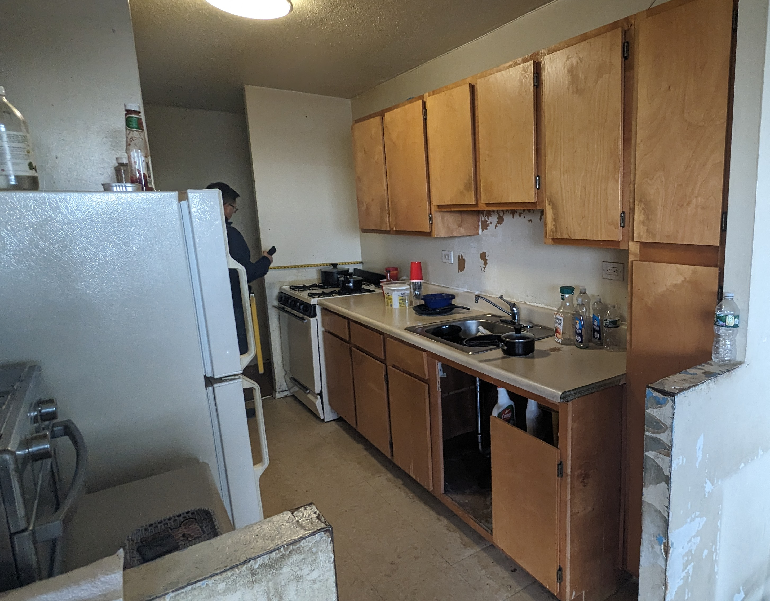
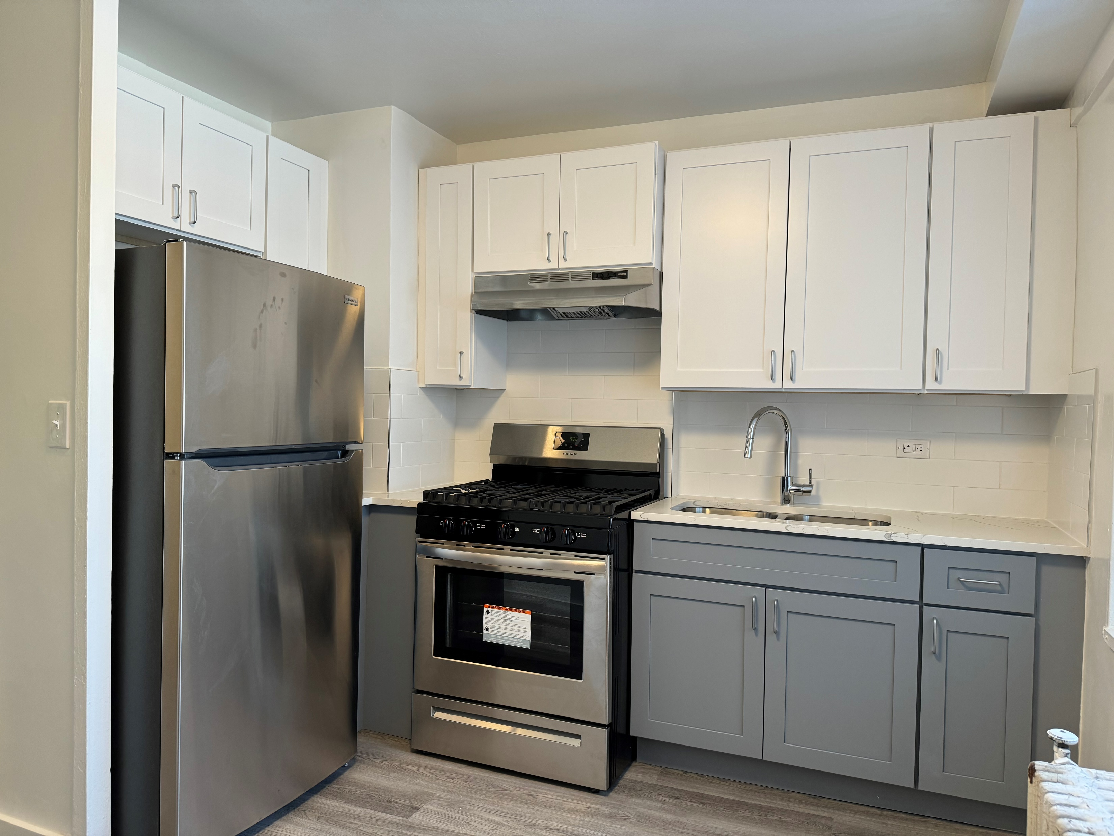
Renovations: Apartment Work
New flooring in kitchens and bathrooms
New appliances (range, hood, fridge) and new exhaust grill/louver
New kitchen cabinets and countertops
New fixtures (faucets, sinks, toilet)
New plumbing connections to all risers
New bathroom accessories
New doors and hardware, as needed
Window repairs and upgrades, as needed
New electrical (GFCI outlets, lighting, switches)
Upgrades to heat, hot water, and electrical systems
Top: Edenwald Kitchen, Before Renovations
Bottom: After Renovations

Slide 21
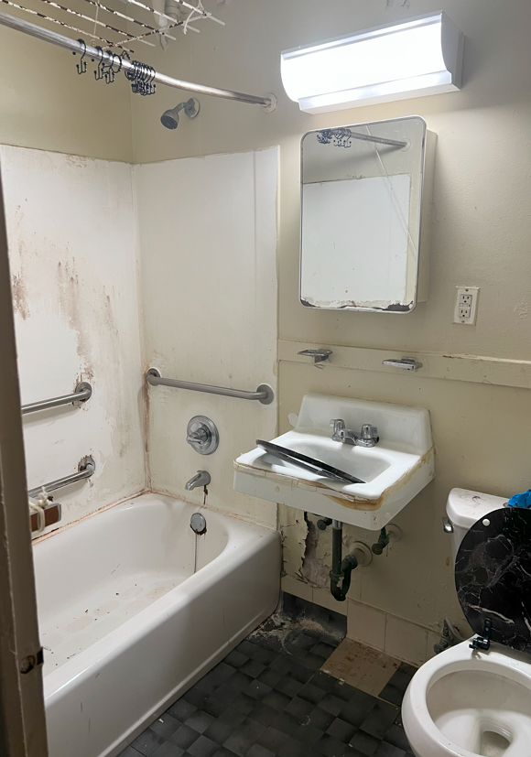
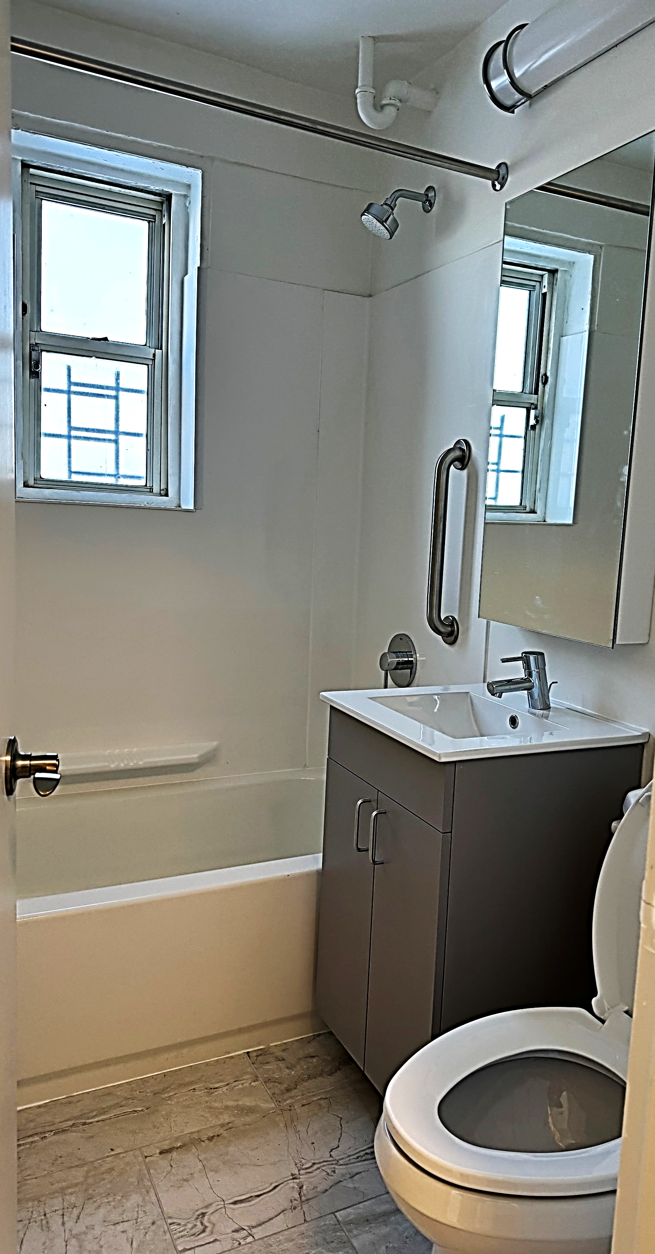
Example of New Bathrooms: Edenwald Houses
Left: Edenwald Bathroom, Before Renovations
Right: After Renovations

Slide 22
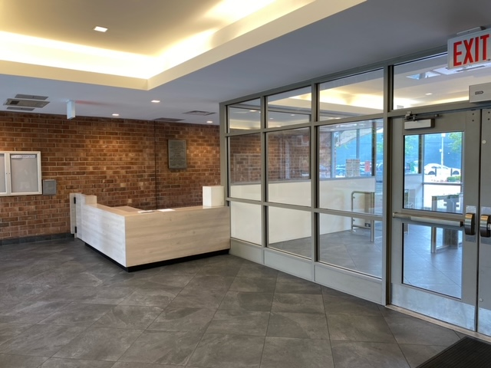
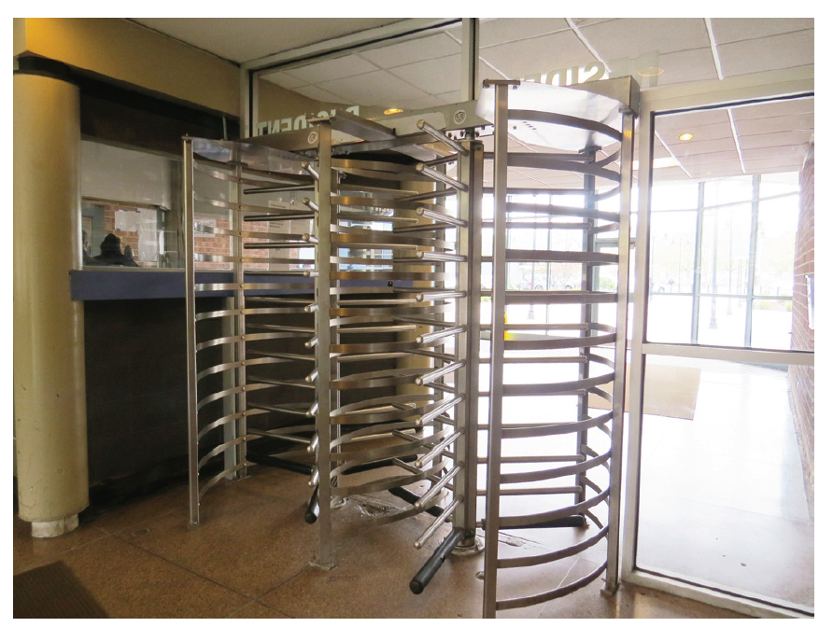
Example of Lobby Improvements: Stevenson Commons
After Rehab
Lobby modernizations
Create more inviting atmosphere with clear sightlines
Meet accessibility code
Before Rehab

Slide 23
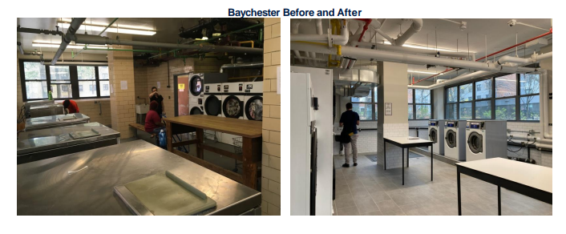
Example of Laundry Room Improvements
Baychester Houses (PACT)
Newly renovated laundry rooms
New machines and enhanced lighting
Improved surveillance in the laundry room
Controlled Access: key fob building entrance

Slide 24
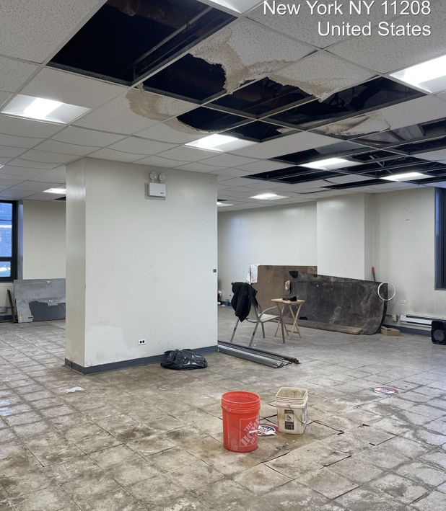
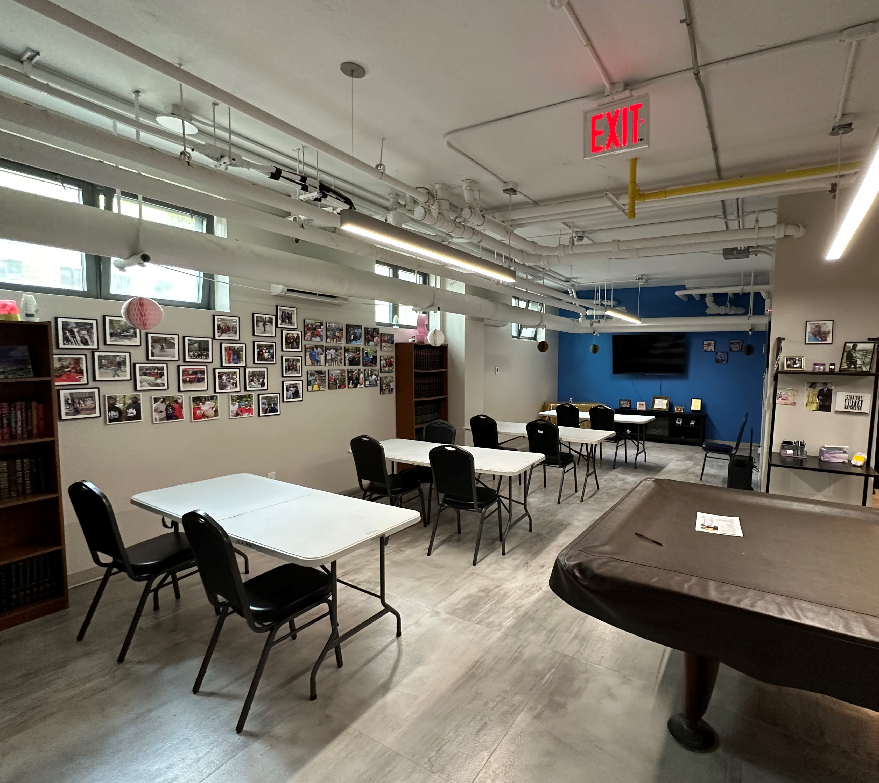
Activating Space for Residents
Potential ideas for discussion: computer lab, senior center, teen center, lending library
Above: Existing community room at Linden Plaza
Top: Baychester Houses TA office common kitchen Bottom: Baychester Houses TA office meeting space

Slide 25
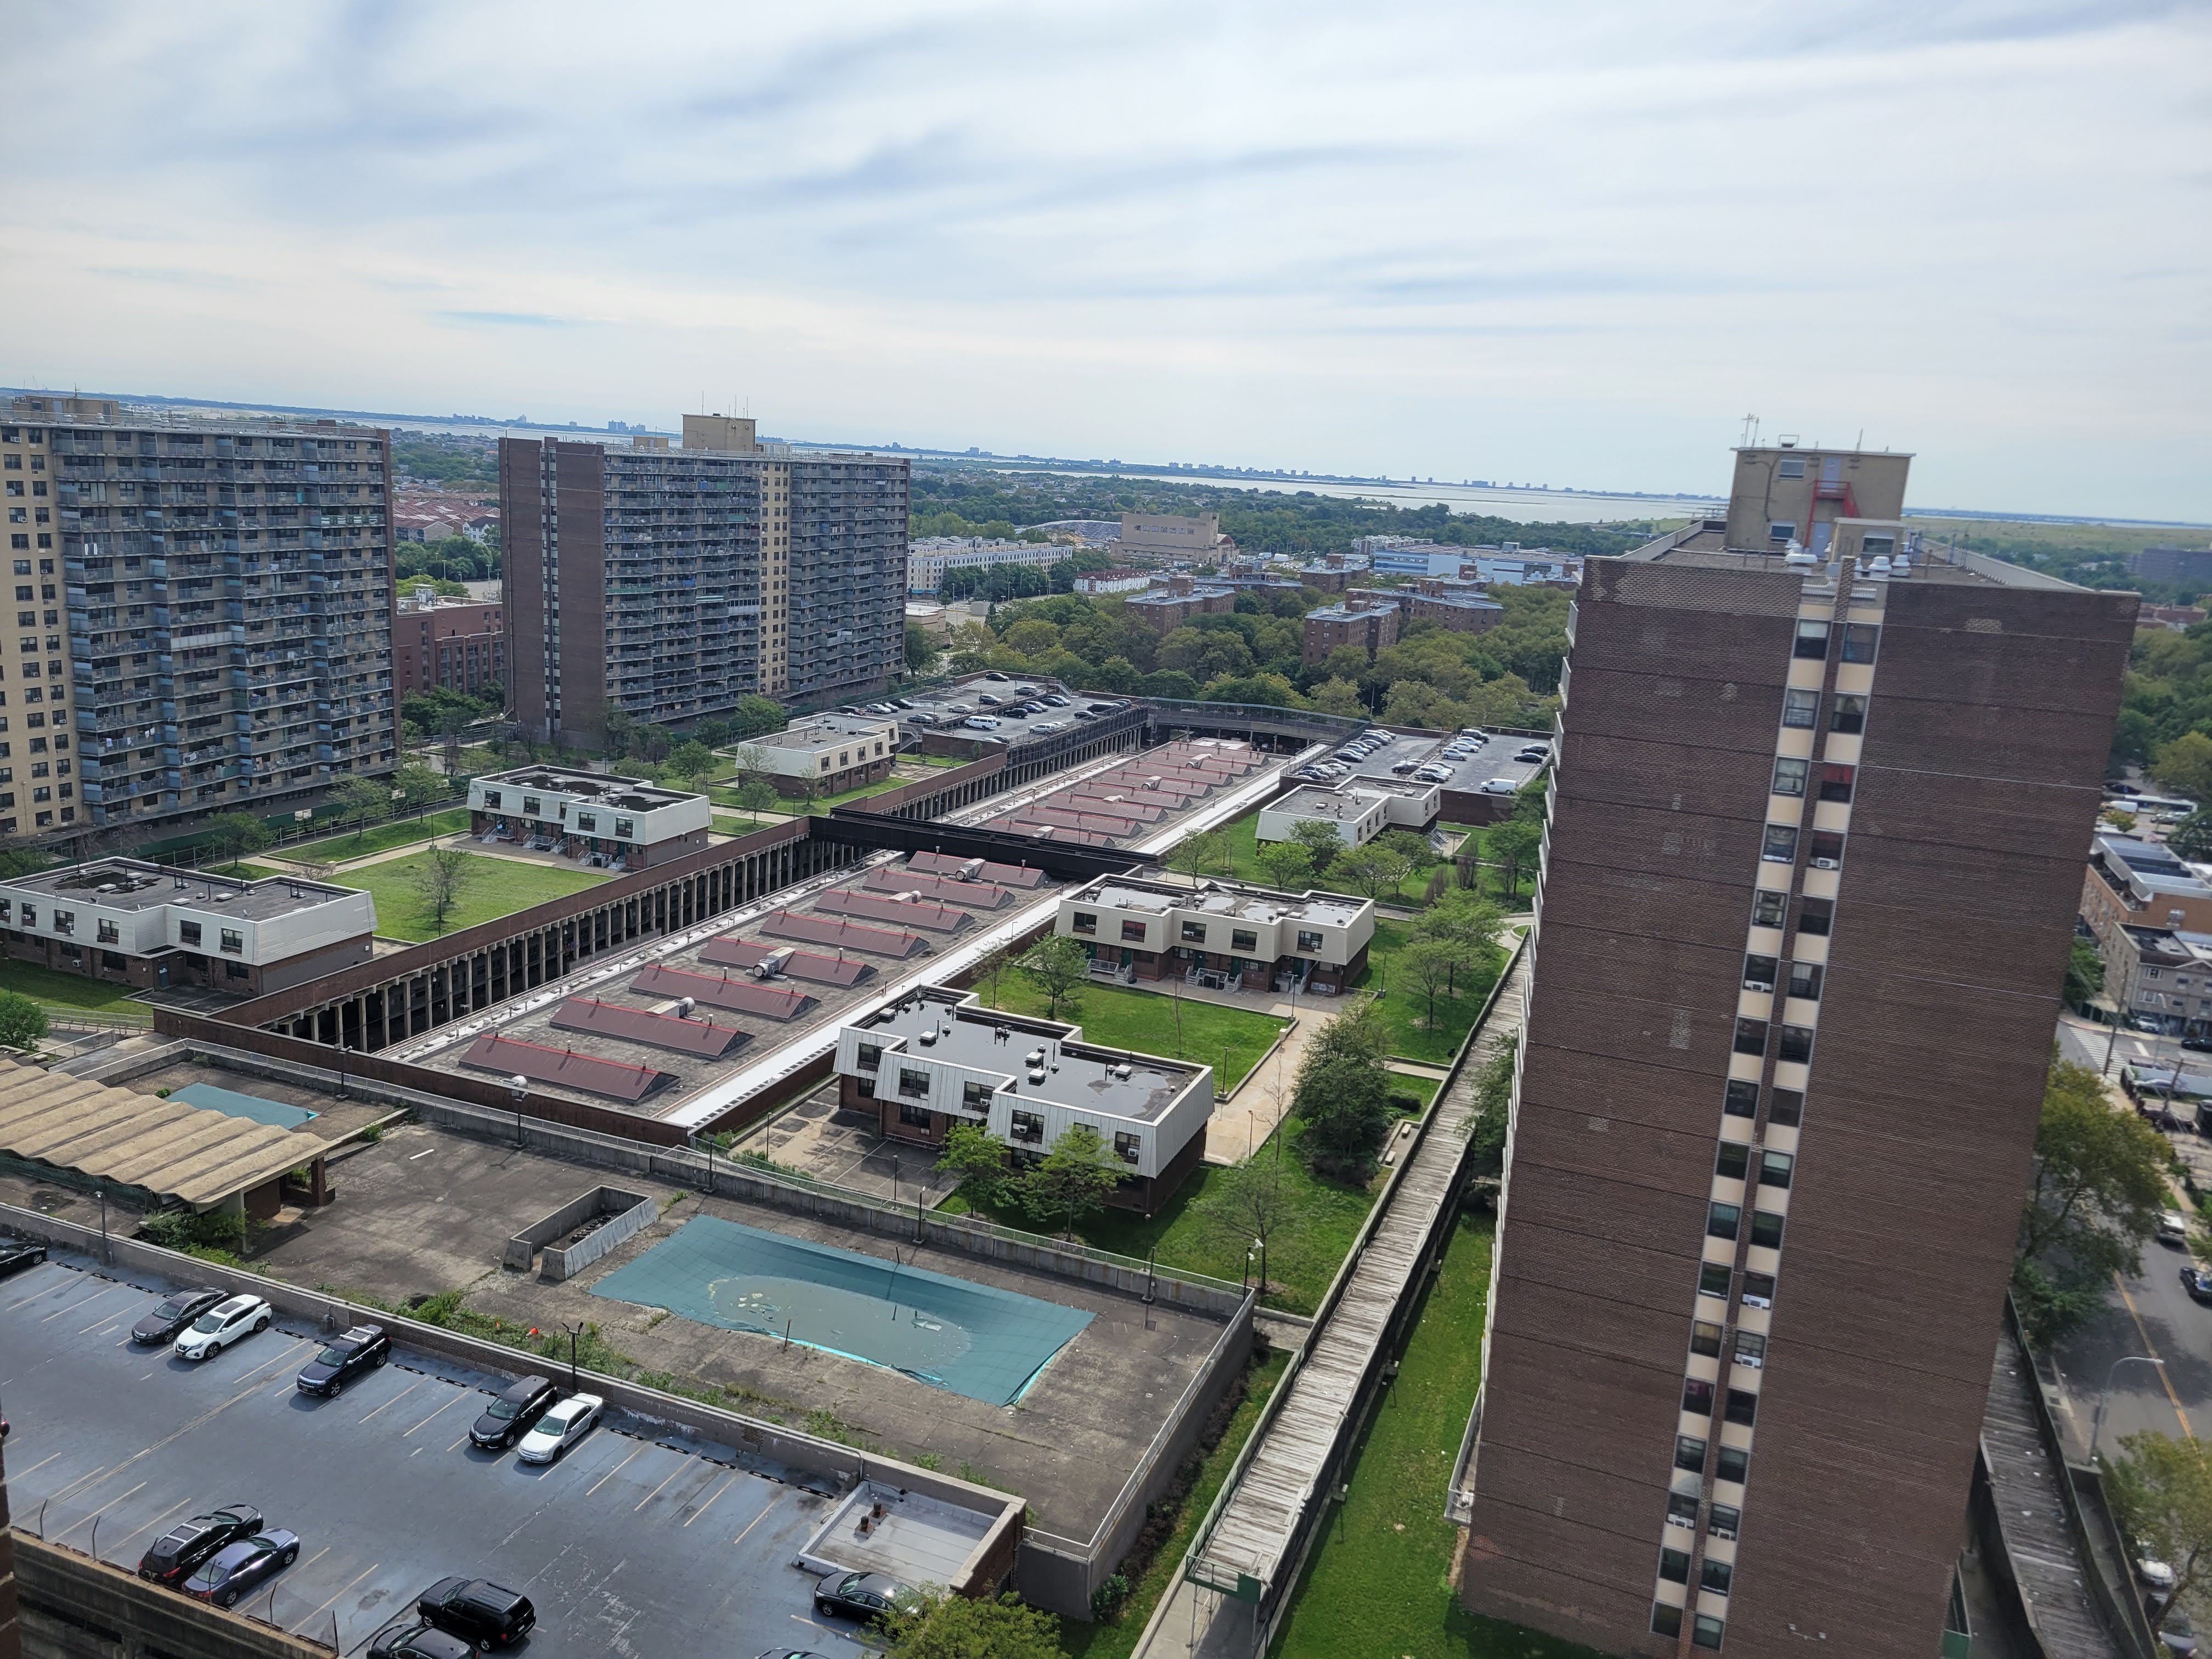
Other Anticipated Improvements at Linden Plaza
Local Law 11 and leak repairs
Additional security enhancements throughout building interiors, inside courtyard and parking areas including key fob access
Renovation of all five community rooms
Addition of housing advocacy group to be provided on site to assist with benefits
Design collaboration with tenant association

Slide 26
5: Next Steps and Future Updates

Slide 27
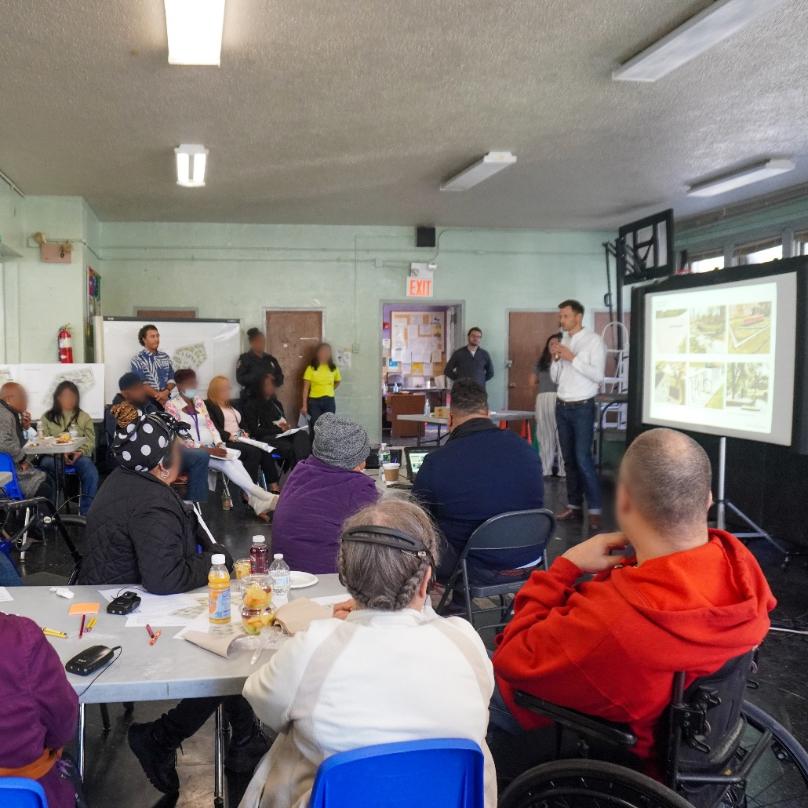
Next Steps
Next resident meeting
HQS, Scope of work, and unit pre-con surveys
Temp Move Details
Commence PBV unit conversions with HQS and certifications
Building-specific meetings: discuss specific issues to guide scope of work
Survey households for temp relocation needs

Slide 28
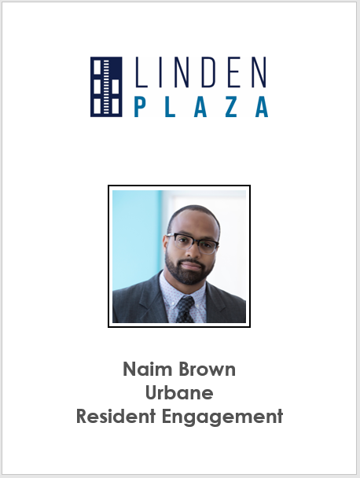
Example Badges

Slide 29
Future Updates
Major project updates will be posted at: www.lindenplazabk.com
Future resident meetings
Rehabilitation information and FAQ’s
Project team contact information
If you are interested in learning more about the new Project-Based Section 8 program and the rehabilitation plan, use the below QR Code and enter your information on the form and we will contact you

Slide 30
Thank You!

